Slide 1


Executive Certificate Program:
Global Business Sustainability by
George Nassos & Bill Blackburn
Quinlan School of Business
Loyola University-Chicago
16 East Pearson
Chicago, IL
May 7, 2018
©2018 William Blackburn Consulting, Ltd.
George Nassos

Slide 2


Your Instructors
Chicago Senior Business Leaders on Sustainability
Sustainability authors, global experts
5 decades inside corporate world!
  George Nassos (formerly , IIT)
  Bill Blackburn (formerly )
.
©2018 William Blackburn Consulting, Ltd.
George Nassos
©2017 William Blackburn Consulting, Ltd.
Notes:
Our style of teaching
Your introductions

Slide 3
Today’s Agenda
The Pursuit of Sustainability by Business: What
Drivers Motivating Companies to Pursue Sustainability: Why; Company Ratings
The Pursuit of Sustainability by Business: How
Design of Sustainable /Green Products and Services
Prioritizing, Planning, Communicating
.
©2017 William Blackburn Consulting, Ltd.

Slide 4

Part I. The Pursuit of Sustainability by Business: What

Slide 5
The Business Setting:
What’s going on in the World?
How is society’s well-being?

Slide 6
Some “Social” Trends
Globalization:
  Transnational corps up 10x from WW II-2000
  World exports up 6x since 1990
Prosperity gap:
  80 individuals own more than bottom 3.5 billion
  Richest 1% own half of world assets
Serious disease:
  3.5 mil./yr. die of AIDS, TB, and malaria
  380 mil. diabetes victims
Notes:
No of TNCs jumped 10x since WW II.
37 of world’s largest companies aren’t countries but companies
Reaction to globalization focus on lose of jobs to outsourcing jobs overseas where environmental and labor standards are lax.
150% increase in International NGOs in 20 years

Slide 7
Some “Social” Trends
Obesity, nutrition:
  WW 600 mil. obese, yet 800 mil. malnourished
  3/4 U.S. adults & 1/3 children overweight
Gender inequality:
  Good strides in education but…
  Women hold only 22% of legislative seats WW
  U.S. women’s salaries 77% of men’s
Privacy:
  1/5 Internet users hacked
  1/9 had data stolen
Notes:
No of TNCs jumped 10x since WW II.
37 of world’s largest companies aren’t countries but companies
Reaction to globalization focus on lose of jobs to outsourcing jobs overseas where environmental and labor standards are lax.
150% increase in International NGOs in 20 years

Slide 8
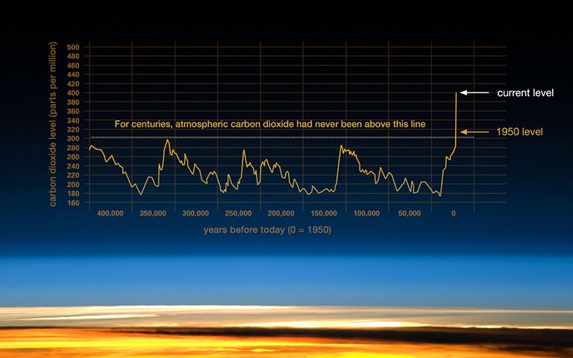
Historic Rise in Global Carbon Dioxide Levels
Since Industrial Revolution
Source: NASA, 2016
Notes:
Greenhouse gas effect discovered by math. Joseph Fourier in 1820s—almost 200 yrs ago; in late 1800s, as Swedish scientist calculated temp impact from doubling of C)2 concentration
Chemical footprints show CO2 is coming from mankind; IPPC: sun energy output, earth orbit & rotation and volcanos likely would have produced cooling over the last 50 years

Slide 9
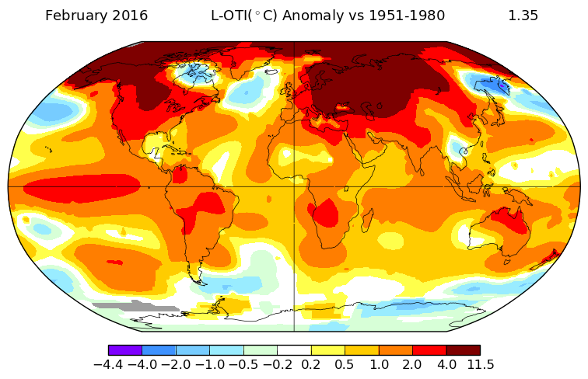
Change in Global Land-Ocean Temperature Index (Average Surface Air Temps. and Sea Surface Temps.)
2016 vs 1951-80
Source: NASA, 2016
°C
Notes:
global temp rose 1 ½ degrees since 1880; over 5 degrees in Alaska. Sea levels have gone up over 7 inches.
Why is warming occurring more in the north?

Slide 10
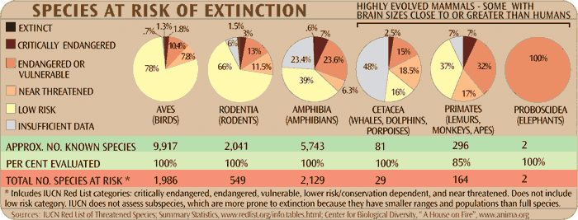
30% of Amphibians,
40% of Primates, All Elephants Endangered
Notes:
5 extinctions, we’re working on 6th
50-500 times faster this time
50 mil year to recover
Destroy habitat
Pollution
Invasive species

Slide 11
Nine Planetary Environmental Boundaries
Earth System Boundary | Indicator | Threshold Proposed? | Status vs Threshold | See Following Trends in Appendix 1
Biodiversity Loss | Extinction rate | Yes | Greatly exceeding | Biodiversity Fish Stocks
Climate Change | Atmospheric C0₂ concentration | Yes | Exceeding and worsening | Climate Change Biodiversity Deforestation Hunger & Malnutrition
Nitrogen & Phosphorus Inputs to Oceans & Biospheres | N₂ removed from atmosphere for human use; Inflow of P into ocean | Yes | N: Greatly exceeding P: Likely to soon exceed | Water Supply & Pollution Traditional Air Pollution Fish Stocks
Global Freshwater Use | Use of water runoff | Yes | Meeting but worsening | Water Supply & Pollution Wetlands
Land System Change | Percentage of land cover converted to cropland | Yes | Meeting but worsening | Soil Quality; Crop Yields Wetlands Deforestation
Ocean Acidification | Mean global ocean surface saturation of aragonite | Yes | Meeting but rate of change uncertain | Climate Change Water Supply & Pollution Coral Reefs Biodiversity
Stratospheric Ozone Depletion | Stratospheric ozone conc. | Yes | Meeting and improving slightly | Ozone Depletion
Atmospheric Aerosol Loading | Regional particulate conc. in atmosphere | Not yet | ___ | Traditional Air Pollution Climate Change
Chemical Pollution | Emissions, conc., or effects of haz. chemicals (e.g., persistent organic pollutants, endocrine disruptors, heavy metals and nuclear waste) | Not yet | ___ | Dangerous Pollutants
Source: Johan Rockström, et.al, “Planetary boundaries: exploring the safe operating space for humanity.” Ecology and Society, (2009)

Slide 12

St. Matthew’s Island:
29 reindeer in 1944; experts say 2300 maximum
Reindeer in 1953?
a. 5
b. 42
c. 1,350
d. 3,000
©2017 William Blackburn Consulting, Ltd.

Slide 13
St. Matthew’s Island:
29 reindeer in 1944; experts say 2300 maximum
Reindeer in 1953?
a. 5
b. 42
c. 1,350
d. 3,000
©2017 William Blackburn Consulting, Ltd.

Slide 14
St. Matthew’s Island:
29 reindeer in 1944; experts say 2300 maximum
Reindeer in 1963?
a. 42
b. 1,350
c. 3,000
d. 6,000
©2017 William Blackburn Consulting, Ltd.

Slide 15
St. Matthew’s Island:
29 reindeer in 1944; experts say 2300 maximum
Reindeer in 1963?
a. 42
b. 1,350
c. 3,000
d. 6,000
©2017 William Blackburn Consulting, Ltd.

Slide 16
St. Matthew’s Island:
29 reindeer in 1944; experts say 2300 maximum
Reindeer in 1966?
a. 42
b. 1,350
c. 3,000
d. 7,500
©2017 William Blackburn Consulting, Ltd.

Slide 17
St. Matthew’s Island:
29 reindeer in 1944; experts say 2300 maximum
Reindeer in 1966?
a. 42
b. 1,350
c. 3,000
d. 7,500
©2017 William Blackburn Consulting, Ltd.

Slide 18


How Fast Does The World Add Enough Additional People to Populate Another U.S.?
Years: a. 1
b. 5
c. 10
d. 25
e. 110
©2017 William Blackburn Consulting, Ltd.

Slide 19
How Fast Does The World Add Enough Additional People to Populate Another U.S.?
Years: a. 1
b. 5
c. 10
d. 25
e. 110
©2017 William Blackburn Consulting, Ltd.

Slide 20
World’s Population
(Billions of people)
Source: Population Reference Bureau (2014), UN (2012)
©2017 William Blackburn Consulting, Ltd.

Slide 21

US Consumption and Waste!
5% of the population
? % of the resources and wastes
©2017 William Blackburn Consulting, Ltd.

Slide 22
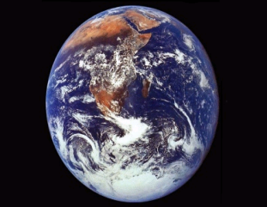
US Consumption and Waste!
5% of the population
25-30% of the resources and wastes
Need 5-6 worlds at current production if everyone consumed at US rates!
Source: United Nations Environment Programme (2012)
©2017 William Blackburn Consulting, Ltd.

Slide 23
Two Questions:
1. Should we care about these issues, about the well-being of humanity?
2. How do these sustainability trends affect businesses?

Slide 24
Sustainability Trends Drive
Reaction of Organizations
Trend
Reaction
Climate Change
Fossil Fuel Depletion
Energy Conservation
Carbon Footprinting
Over Consumption
of Resources
Recycling
Recycled Content
Dematerialization
Changing Population
Profile
Diversity Programs

Slide 25
Sustainability Trends Drive
Reaction of Organizations
Trend
Reaction
Child and Forced Labor
Growing Concern about Toxics Contam. & Env. Problems
Ethical Sourcing
Supplier Assessments
Spread of Toxic
Pollutants
Toxics Elimination
From Inks, Electronics, etc.
Growing Mistrust of
Business
Sustainability Rptg.
Green Labeling Rules
Product Certifications

Slide 26
Business can choose to…
1. Care and try to be in control, or,
2. Not care and be out of control.

Slide 27


What is sustainability?
(and how do you determine that?)
©2017 William Blackburn Consulting, Ltd.

Slide 28
History of Sustainability
1980s
1990s
2000 +
1960s-70s
-Silent Spring
-AIDS
-Exxon Valdez Oil Spill
-UN Brundtland Comm.
-Triple Bottom Line
-Nike, Gap Contractor Sweatshops
-Enron
-An Inconvenient Truth
-Pope’s Encyclical on Care for Our Common Home
-Bhopal
-GRI
-UN Global Compact
-AASHE ,
-IIRC, SASB
STAR Comm. Index
-BP Disaster
-IPCC
-UN Conf on Human Env.
-Soweto Apartheid Protests
-EPA, OSHA
-Love Canal H.W. Site
©2017 William Blackburn Consulting, Ltd
Notes:
TBL= John Elkington
Enron= Sarbanes Oxley
Bhopal= India cyanide gas release—over 3500 deaths
BP Gulf oil explosion and release=almost 5 mil gal.; 11 people; $42 Bil. Fines and liab.

Slide 29
Defining Sustainability Obligations
Going beyond Brundtland, TBL
Implied expectations (GRI, CSR Reports)
Express expectations of global stakeholders
  Voluntary standards (GRI, ISO 26000, UN Global Compact, Ethos Indicators, STARS, Star Community Index, SA 8000, UN Human Rts. Guide, LEED, industry standards, etc.)
  Mandatory integrated reporting standards (UK, S. Africa, France, Sweden, Denmark, et al.)
  Supplier sustainability codes of conduct
  UN Sustainable Development Goals
©2012 William Blackburn Consulting, Ltd.
©2017 William Blackburn Consulting, Ltd.
Notes:
Identified expectations of stakeholders from direct engagements
NAFTA story—what do you think were their main concerns?

Slide 30
Related Terminology
Sustainable Development
People, Planet & Profit
Sustainable Growth
Corporate Citizenship
Social Responsibility; Corporate Social Responsibility (CSR)

Slide 31


Growing Global Multi-stakeholder Consensus on SR/Sustainability Scope
ISO 26000 SR Core Subjects | GRI Sustainability Indicator Categories/Aspects
Organizational Governance | Governance
Human Rights | Human Rights
Labour Practices | Labor Practices & Decent Work
The Environment | Environment
Fair Operating Practices | Society: Corruption, Public Policy, Anti-competitive Behavior, etc.
Consumer Issues | Product Responsibility
Community Involvement & Development | Society: Community Economic: Indirect Economic Impacts
 | Economic: Economic Performance, Market Performance, etc.
©2017 William Blackburn Consulting, Ltd.

Slide 32
Sustainability Topics that Stakeholders
Expect Companies to Address*
Governance (oversight structures and systems for legal and ethical compliance and risk control on below topics for organization and its supply chain)
Human Rights (civil rights, nondiscrimination, etc.)
Labor Practices (wages, working conditions, etc.)
Environmental Issues (pollution, energy and resource conservation, biodiversity, etc.)
Fair Operating Practices (anti-corruption, fair competition, etc.)
Consumer/customer Issues (fair marketing, consumer safety, product compliance, etc.)
Community Involvement & Development
Economic Viability of the Organization (GRI only)
*Based on the GRI reporting guidelines and ISO 26000 SR standard
©2017 William Blackburn Consulting, Ltd.

Slide 33
UN Global Compact
Globally most popular sustainability principles
Over 9,000 company signatories and 3,000 others, in 130 countries
Signatories must:
  Have CEO and Board adopt UNGC Principles
  Respect the Principles across operations and supply chains
  Provide advocacy, collaboration and philanthropy for society
  Submit an annual Communication on Progress (COP) report on conformance with the Principles (most use their GRI reports)
  Participate in the relevant UNGC Local Network
©2017 William Blackburn Consulting, Ltd.

Slide 34
UN Global Compact
Human Rights*
Businesses should:
support and respect the protection of internationally proclaimed human rights; and
make sure that they are not complicit in human rights abuses.
*UN Universal Declaration of Human Rights covers, e.g.:
freedoms of speech, religion, privacy, association, peaceful assembly;
freedom from discrimination, slavery, arbitrary arrest and cruel punishment; and,
rights to education, elections, marry at full age, work, good working conditions, a decent standard of living, social security, equal protection under law, presumption of innocence, competent courts, and a nationality.
©2017 William Blackburn Consulting, Ltd

Slide 35
UN Global Compact
Labour
Businesses should:
uphold the freedom of association and the effective recognition of the right to collective bargaining;
the elimination of all forms of forced and compulsory labour;
the effective abolition of child labour; and
the elimination of discrimination in respect of employment and occupation.

Slide 36
UN Global Compact
Environment
Businesses should:
support a precautionary approach to environmental challenges;
undertake initiatives to promote greater environmental responsibility; and
encourage the development and diffusion of environmentally friendly technologies.
Anti-Corruption
10. Businesses should work against corruption in all its forms, including extortion and bribery.
©2017 William Blackburn Consulting, Ltd

Slide 37

2015-30 SDG Topics

Slide 38
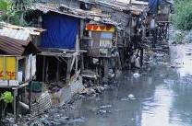
Issues Addressed by the
2015-30 UN Sustainable Development Goals
Extreme poverty and hunger
Universal primary education
Gender equality
Better health (HIV/AIDS, malaria and other diseases; child mortality, maternal mortality and health, etc.)
Environmental progress (climate change, water & sanitation, biodiversity, oceans, forests, etc.)
Access to sustainable energy
Sustainable industrialization, consumption & production
Full employment
Safe, peaceful communities; access to justice
Global partnerships to help developing nations
©2017 William Blackburn Consulting, Ltd.
Notes:
Environmental sustainability (env. resources, drinking water and sanitation, slum conditions)
Global partnerships to help developing nations (good governance, exports, reduced debt, work for youth, access to pharmaceuticals, new technologies)

Slide 39
Commitment to Values & Integration are Keys to Sustainability Leadership
“Companies…are now increasingly integrating sustainability into how they manage every aspect of the business…” --2014 Study by National Association of Environmental Management (NAEM)
A long term commitment to sustainability values integrated deeply within the organization, along with ambitious targets and polices, are the primary reasons a company is considered a sustainability leader. --2014 GlobeScan/SustainAbility survey of over 800 experts in 87 countries
©2014 William Blackburn Consulting, Ltd.
©2017 William Blackburn Consulting, Ltd.

Slide 40
Practical Definition of
Sustainability
“The 2 Rs”
R
R
Values-driven management based on---
Respect: for people and other living things;
Resources: the wise use of economic and natural resources
    —for the purpose of sustaining and promoting the long-term well-being of the organization and society (including the environment).
©2017 William Blackburn Consulting, Ltd.

Slide 41
What is a Sustainable/ Green Product and Service?

Slide 42

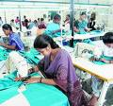
Sustainable Products & Services
Improve the efficient use of natural and economic resources along the product life cycle
Provide greater respect and accommodation for the needs of people and other living things along the product life cycle
©2017 William Blackburn Consulting, Ltd.

Slide 43


















The Conference Board Sustainability Benchmarking Studies
(See www.WBlackburnConsulting.com)
©2017 William Blackburn Consulting, Ltd.
Notes:
Alcan, acquired by Rio Tinto
Aveda part of Estee Lauder

Slide 44


Conference Board Study:
A Corporate Commitment to Sustainability
(A Sample Sustainability Policy)
It is within the best interests of our company and society as a whole that our company move along the path to sustainability. To that end, we will strive to achieve the following vision of performance:
1. Economic success: the wise use of financial resources
a. Company Economic Prosperity
Our business will be positioned to survive and prosper economically.
b. Community Economic Prosperity
We will help our community survive and prosper economically.

Slide 45
2. Social responsibility: respect for people
a. Respect for Employees
We will treat our employees in a respectful, fair, non-exploitative way, especially with regard to compensation and benefits; promotion; training; open, constructive dialogue with management; involvement in decision-making; working conditions that are safe, healthy and non-coercive; rights of association, collective bargaining and privacy; employment-termination practices; and work-life balance.
b. Diversity, Fair Hiring Practices
We will promote diversity and use employment practices that are fair, responsible, non-discriminatory, and non-exploitative for our employees, board members, and suppliers.
c. Responsible Governance
We will manage our risks properly, use our economic power responsibly and operate our business in a way that is ethical and legal.
d. Respect for Stakeholders
We will be transparent, respectful and fair to local populations, investors, suppliers and other stakeholders outside our organization who may be affected by our operations. We will work collaboratively with our communities, governments and supply chain to enhance the well-being of others.
e. Fair Dealing With Customers
We will be honest and fair with our customers, competing fairly for their business, anticipating their needs, respecting their privacy, and providing them safe and effective products and services under the conditions we promise.

Slide 46

3. Environmental responsibility: respect for life; the wise management and use of natural resources
a. Resource Conservation
We will conserve our use of natural resources to the extent practicable.
b. Waste Prevention and Management
We will reduce to the extent practicable the volume and degree of hazard of the wastes we generate from our operations, and handle them in a safe, legal and responsible way to minimize their environmental effects.
c. Environmental Risk Control and Restoration
We will minimize the risk of spills and other potentially harmful environmental incidents, restore the environment where damaged by us, and enhance it to better support biodiversity.
d. Supply Chain Impacts
We will work with others in our supply chain to help ensure environmental impacts and risks associated with our products and services are reduced and properly controlled.
e. Collaboration With Communities
We will collaborate with our communities to protect and improve the environment.

Slide 47
Examples of
Economic Topics
Brand strength Capital expenditures Cash flow Credit rating Dividends Debt and interest Income | Liabilities Market share Sales Profits Retained earnings R&D investment Return on investment | Community donations Local purchasing Taxes Tax subsidies

Slide 48
Examples of Social Topics
Access to healthcare by the poor Anti-sexual harassment policies Antitrust practices Bioterrorism Board diversity Bribery and corruption Charitable donations Child labor Community outreach Consumer privacy Corporate governance Consumer privacy Disciplinary practices Emergency preparedness Employee assistance programs Employee diversity Employee layoff policies Employee privacy | Employee relations Employee shared values Employee training & development Employee turnover Employee wellness programs Employee work-life balance Employment Ethics Fair advertising and labeling Flexible work options Food product nutrition Forced labor Helping the disadvantaged Human rights (security policies, etc.) Impacts on local culture Indigenous rights Indoor air pollution Industrial hygiene | Legal compliance on social topics Non-discrimination policies Occupational health Political contributions Producer responsibility Product labeling Product quality Product safety Product usefulness Securities regulation Supplier diversity Support for community services Transparent public reporting Union relations Worker violence Workplace safety

Slide 49
Examples of
Environmental Topics
Air pollution Animal rights Biodiversity Chemical spills Compliance with environmental laws & permits Customer disposal of products Endangered species Energy conservation Environmentally sensitive design | Greenhouse gases Natural habitat restoration Natural resource usage Ozone-depleting substances Packaging reduction Pollution prevention Precautionary Principle Product energy use Product take-back | Recycling Renewable energy & materials Soil contamination Soil erosion/depletion Spill prevention Waste disposal Water conservation Water pollution Wetlands protection Wildlife conservation

Slide 50

Some Observations
About Sustainability
Sustainability is not about one thing.
The business case for sustainability is really the business case for a process that looks at sustainability trends and issues and prioritizes among the opportunities and threats to an organization to select those for action that contribute the most value.
©2017 William Blackburn Consulting, Ltd.

Slide 51
Common Organizational
Threats and Opportunities
Threats | Opportunities
-Legal -Financial -Reputational -Competitive -Operational | -Productivity, cost -Employee relations -Reputation, brand -License to operate, community appeal -Sales, new markets, customer appeal -Innovation, new products and services

Slide 52
A Risk Perspective: The Precautionary Principle
Principle 15 of the Rio Declaration of the 1992 Earth Summit (U.N. Conference on Environ­ment and Development)
“When an activity raises threats of harm to human health or the environment, precautionary measures should be taken even if some cause-and-effect relationships are not fully established scientifically.”—1998 Wingspread Conf. of the Science and Environmental Network
©2017 William Blackburn Consulting, Ltd..

Slide 53
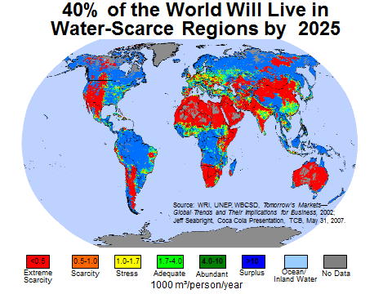

Slide 54
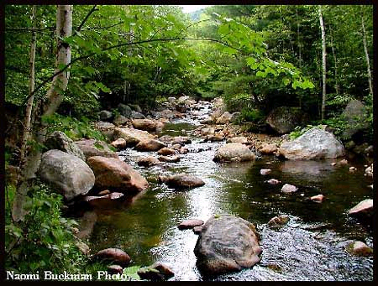
Sample SWOT Analysis for Sustainability Issue: Water
Issue | Threat | Opportunity | Strength | Weakness | Possible Objectives
Depletion of Fresh Water Resources | 1. Water shortage could jeopardize operations 2. Some competitors have long-term water rights | 1. Water conservation projects can save money, help secure supply 2. More on-site water treatment and reuse are possible 3. May be able to secure long- term water rights in some locations | 1.Some water conservation projects underway 2. Internal engineering expertise | 1. No long-term water rights secured in some growth regions 2.Some communities serving our factories have poor water supply infrastructure | 1. Investigate water risks on site-by-site basis and develop actions to address them 2. Consider more aggressive water treatment, reuse and conservation programs using internal engineers 3. Explore securing long-term water supplies in high risk areas while respecting community needs

Slide 55
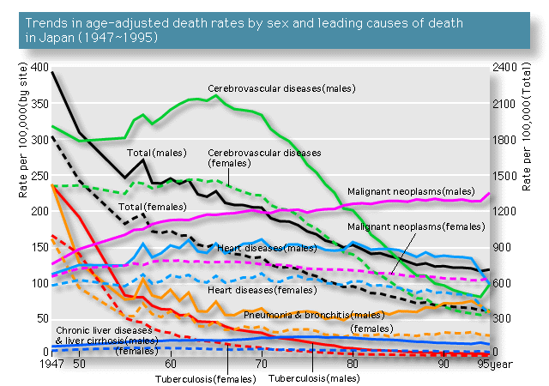
Sustainability Trends
Conditions Responses
Growth in Global Business Competition
Speed of Communications/ Digital Divide
Widening Prosperity Gap (Health, Income, Services)
Population Growth
Serious Disease
Mental Health Problems
Increased Immigration; Lower Fertility in Industrialized Nations
Hunger and Malnutrition
Child and Forced Labor
Education Needs for the Disenfranchised
Urbanization
Privacy
Over-consumption of Resources
Obesity; Poor Food Nutrition
Fossil Fuel Depletion
Climate Change
Deforestation
Threats to Biodiversity
Fresh Water Depletion/ Water Contamination
Wetlands Destruction
Fish Depletion
Coral Reef Destruction
Spread of Hazardous Pollutants
Declining Soil Quality
Ozone Depletion
Declining Corporate Credibility
Opposition to Globalization
Extended Producer Responsibility
Green Products
Green Marketing/Labeling
Green Product Certification
Socially Responsible Investing
Investor Concerns about Corporate Governance
Transparency/ Public Reporting
Power of NGOs/CSOs
Notes:
No of TNCs jumped 10x since WW II.
37 of world’s largest companies aren’t countries but companies
Reaction to globalization focus on lose of jobs to outsourcing jobs overseas where environmental and labor standards are lax.
Extended Producer Resp: proactively control risk; hazards info, responsible for harm; take back
SRI=1 of every $9 of managed portfolio investments in the US take into account social or environmental factors
150% increase in International NGOs in 20 years

Slide 56
Part II. Drivers Motivating Companies to Pursue Sustainability: Why
Company Ratings

Slide 57
Why Do Companies Seek Sustainability?
What are the drivers?
What is really happening in industry?
What do the ratings say?
What do the investors think?
©2017 George P. Nassos & Associates, Inc.
Notes:
Discuss this question first?

Slide 58
What do you think are some drivers?
Environmental
Social
©2017 George P. Nassos & Associates, Inc.
Notes:
Delete bullets and just leave title question for discussion?

Slide 59
Let’s Look at the Drivers
Profitability
Employees
Image
Marketing
Social Consciousness/Ethics
Competitive Advantage
Attracting Capital
Socially Responsible Investing
Survival
Product Innovation
©2017 George P. Nassos & Associates, Inc.

Slide 60
One of Management’s Most Important Drivers: Economics
©2017 George P. Nassos & Associates, Inc.

Slide 61
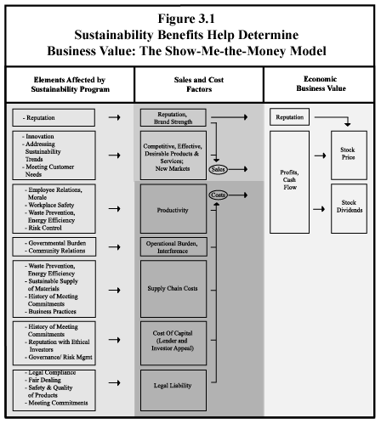
©2017 William Blackburn Consulting, Ltd.

Slide 62
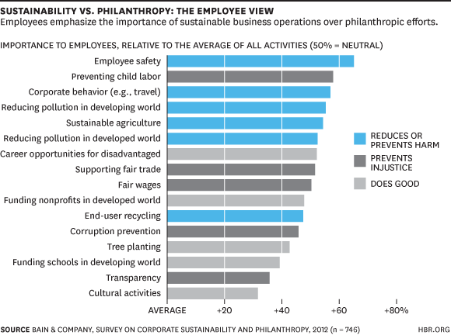
Employee Attraction

Slide 63
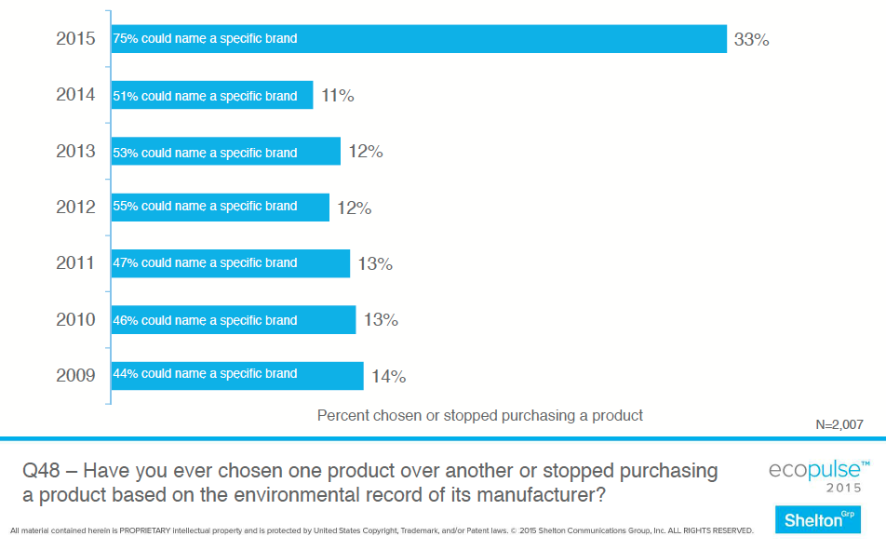
Impact of Image on Product Selection

Slide 64
Using Marketing to Drive Sustainability
Charter Bank – encourages electronic banking
©2017 George P. Nassos & Associates, Inc.

Slide 65
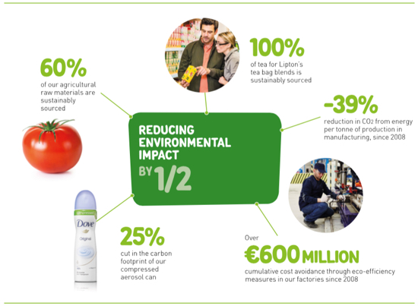
Social Consciousness Leads to Sustainable Living Brands

Slide 66
Whole Foods Mission: Achieve a Competitive Advantage
Reduce, reuse, recycle
Alternative energy
  Solar and wind
  Electric and biodiesel vehicles
Green buildings
Product sourcing and packaging
Community support
©2017 George P. Nassos & Associates, Inc.

Slide 67
Increase in Socially Responsible Investing
Increase by 1/3 from 2014 to 2016
Currently at $8.7 trillion
Represents over 1/5 of $40 trillion in total assets
Community investments: $64 billion to $122 billion
SRI performance comparable to broad market indexes
©2017 George P. Nassos & Associates, Inc.

Slide 68
Dow Jones Sustainability Group Index
World’s first sustainability index – 1999
Assessed almost 2,000 companies in 2016
Criteria
  Materiality
  Impact Measurement and Valuation
  Labor Practice Indicators and Human Rights
  Brand Management
©2017 George P. Nassos & Associates, Inc.

Slide 69
“Sustainable” Companies
Deliver more predictable results
Don’t necessarily have outstanding growth – just reliable above average performance
Investors stay long term
©2017 George P. Nassos & Associates, Inc.

Slide 70
DJSGI Changes
U.S. Largest Additions | U.S. Largest Deletions
Merck & Co. | Exxon Mobil Corp
PepsiCo Inc. | EMC Corp.
Schlumberger Ltd. | Allstate Corp.
Allergan plc | Spectra Energy Corp.
Adobe Systems Inc. | Baker Hughes Inc.
©2017 George P. Nassos & Associates, Inc.

Slide 71
Some Companies Must Seek to Survive
Fisheries
Vineyards
Almond production
©2017 George P. Nassos & Associates, Inc.

Slide 72
What is Really Happening in Industry?
Accenture Report for UN Global Compact
  93% critical to success
  96% integrated into strategy
Weinreb Group found 36 U.S. CSOs (2014)
  Up from 29 in 2011
  42% women, up from 29% in 2011
©2017 George P. Nassos & Associates, Inc.

Slide 73
Companies for Diversity
Talent Pipeline
Talent Development
Leadership Accountability
Supplier Diversity
©2017 George P. Nassos & Associates, Inc.

Slide 74
Top Diversity Companies 2016
Kaiser Permanente
Novartis
EY
AT&T
PWC
Sodexo
Master Card
Johnson & Johnson
Marriott
Prudential Financial
Deloitte
Well Fargo
P & G
Abbott
Accenture
KPMG
Merck
Cox
Cummins
IBM
©2017 George P. Nassos & Associates, Inc.

Slide 75
Companies Caring for Employee Health
Minimize stress
Health insurance
Vacation programs
Healthy cafeterias
©2017 George P. Nassos & Associates, Inc.

Slide 76
Top Companies for Health Benefits
Large Companies
Medium & Small
Kaiser Permanente
General Electric
Whole Foods
EMC
Microsoft
Mayo Clinic
Google
General Mills
Genentech
Kimpton Hotels
SAS
Twitter
White Wave Foods
Red Ventures
Zappos
Hasbro
©2017 George P. Nassos & Associates, Inc.

Slide 77
What do you think are some sustainable companies?
Does it help growth?
Does it help survival?

Slide 78
Sustainability Disclosure
Top Brands (2013) | ESG Score | Top ESG Companies | Score
Apple | 14 | Intel | 71
Google | 29 | Mercedes Benz | 69
Coca Cola | 64 | Coca Cola | 64
IBM | 47 | BMW | 64
Microsoft | 36 | Sprite | 64
G.E. | 60 | Louis Vuitton | 63
McDonald’s | 27 | Kia | 61
Samsung | 58 | Gucci | 60
Intel | 71 | Cisco | 59
Toyota | 32 | UPE | 58
©2017 George P. Nassos & Associates, Inc.

Slide 79
Exxon-Mobil
(add diversity?)
Received AIChE award for commitment to safety – 2015
Alternative energy – algae to biofuel
  2009 committed $600 million
  2013 stopped at $100 million
Sued for GHG emission cover-up – Sept. 2016
©2017 George P. Nassos & Associates, Inc.

Slide 80
Exxon-Mobil
Employees featured – 12 women, 7 men
C-Suite – 24 men, 0 women
Solution – spend $20 million on 233 Olympics commercials 2016
©2017 George P. Nassos & Associates, Inc.

Slide 81
What About Whole Foods?
Last Sustainability Report – 2013
Green Missions Report – 2012
No goals
No sustainability plan
Not on Corporate Knights Top 100
Newsweek 2016 Green Rating – 239
©2017 George P. Nassos & Associates, Inc.

Slide 82
Greener Companies and We Don’t Know It
Anheuser-Busch
Nokia
Proctor and Gamble
©2017 George P. Nassos & Associates, Inc.

Slide 83
Procter & Gamble
Improve lives of consumers
Company is 175 years old – another 175 years?
Only renewable energy – no landfilling
Cold water washing
Reduce diaper weight
Enviro-packs
Among top companies for diversity
©2017 George P. Nassos & Associates, Inc.

Slide 84
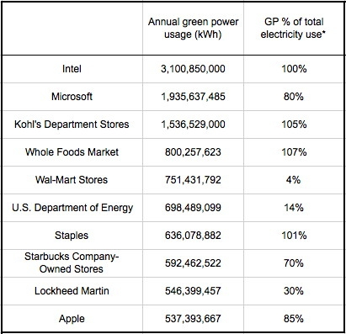
Largest Consumers of Renewable Energy
©2017 George P. Nassos & Associates, Inc.

Slide 85
And Here is More Evidence of “Sustainable” Companies
Wal-Mart – largest buyer of organic cotton
General Motors –
  largest user of landfill gas
  24 plants – no waste to landfills
  Eliminated 86 lb./car packaging waste
Starbucks – one of largest buyers of fair-trade coffee
Home Depot – largest buyer of FSC wood
McDonald’s – one of largest buyers of recycled products; eliminated embossed napkins = 100 tractor-trailers per year
©2017 George P. Nassos & Associates, Inc.

Slide 86
Unilever’s Success Through Sustainability
Launched USLP in 2010
Double in size – reduce footprint 50%
Products touch 2 billion people every day
Apply six steps
  Ask right question
  Think long term
  Create networks
  Embed sustainability
  Push out to customers
  Change the system
©2017 George P. Nassos & Associates, Inc.

Slide 87
The Walmart Story
Introduced Sustainability Index – 2009
Scores not coming in – or – not being shared
Launched iSVN – January 2012
Integrate scorecards into merchandising
Three goals of their suppliers:
  100% renewable energy
  Zero waste
  Products sustainable to environment and people
©2017 George P. Nassos & Associates, Inc.

Slide 88
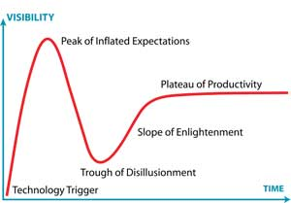
Gartner Hype Cycle – Where is Walmart?
2005
today
©2017 George P. Nassos & Associates, Inc.

Slide 89
Is Walmart Really “Sustainable”?
Much larger since 2005
Buy more – throw out more
Emissions continue to grow – don’t report all
Sustainability Index progressing slowly
Sprawl adding to climate change
Fund anti-environment candidates
Huge growth in food distribution
Employee benefit reform on the horizon?
©2017 George P. Nassos & Associates, Inc.

Slide 90


Slide 91
What is a Green Business?
Is there a standard?
  Global Compact
What about
  Corporate Knights
  Green stock indices
  Green Business Network
  GRI
  ISO 14001
©2017 George P. Nassos & Associates, Inc.

Slide 92
Best Global Green Brands - 2014
Rank | Brand | Industry | Gap
1 | Ford | Automotive | +3.2
2 | Toyota | Automotive | +0.3
3 | Honda | Automotive | +1.8
4 | Nissan | Automotive | +6.6
5 | Panasonic | Electronics | +13.9
6 | Nokia | Electronics | +19.0
7 | Sony | Electronics | +10.7
8 | Adidas | Sporting Goods | +6.1
9 | Danone | FMCG | -1.3
10 | Dell | Technology | -16.9
©2017 George P. Nassos & Associates, Inc.

Slide 93
Selected Best Global Green Brands - 2014
Rank | Brand | Industry | Gap
21 | Apple | Technology | -1.1
23 | General Electric | Capital Goods | -1.8
32 | Chevrolet | Automotive | -2.9
37 | Starbucks | Restaurants | -2.0
38 | Kellogg’s | FMCG | -6.0
41 | Microsoft | Technology | -9.1
43 | McDonalds | Restaurants | -14.5
46 | Caterpillar | Capital Goods | +3.1
48 | Colgate | FMCG | -7.0
49 | Disney | Media | -9.1
©2017 George P. Nassos & Associates, Inc.

Slide 94
Corporate Knights Rankings
Worked with three other firms
Trimmed list of 3,500 to 400
Looked at 11 different environmental, social and governance performance measures
  Energy productivity
  Waste productivity
  CEO-to-average-worker pay ratio
  Employee turnover
©2017 George P. Nassos & Associates, Inc.

Slide 95
Corporate Knights Most Sustainable Companies for 2016
Rank | Company | Country | Industry
1 | BMW | Germany | Automotive
2 | Dassault Systems | France | Software
3 | Outotec | Finland | Construction
4 | Commonwealth Bank of Australia | Australia | Banks
5 | Adidas | Germany | Apparel
6 | Enagas | Spain | Utilities
7 | Danske Bank | Denmark | Banks
8 | StarHub | Singapore | Wireless IT
9 | Reckitt Benckiser Group | United Kingdom | Household
10 | City Developments | Singapore | Real Estate
©2017 George P. Nassos & Associates, Inc.

Slide 96
Corporate Knights Most Sustainable Companies for 2016
Rank | Company | Country | Industry
11 | Centrica | United Kingdom | Multi-Utilities
12 | Schneider Electric | France | Electrical Equipment
13 | Coca-Cola Enterprises | United States | Beverages
14 | L’Oreal | France | Personal Products
15 | Kesko | Finland | Food & Staples
16 | Galp Energia | Portugal | Oil & Gas
17 | Statoil | Norway | Oil & Gas
18 | Shinhan Financial | South Korea | Banks
19 | Novo Nordisk | Denmark | Pharmaceuticals
20 | Hennes & Mauritz | Sweden | Specialty Products
©2017 George P. Nassos & Associates, Inc.

Slide 97
Too Many Ratings
Climate Counts
Norm Thompson
Herman Miller
Steelcase
General Electric
Timberland
©2017 George P. Nassos & Associates, Inc.
Notes:
Not just company ratings, here. Some are product ratings.

Slide 98
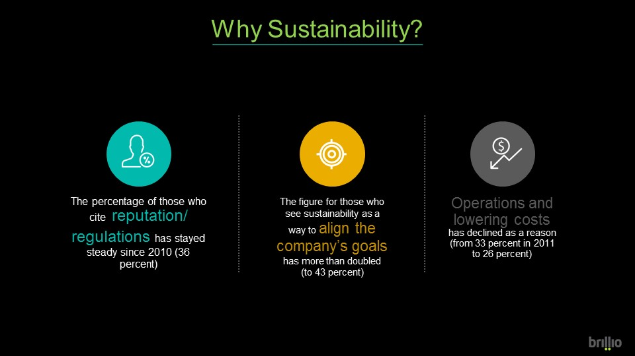

Slide 99
What are your thoughts?
Companies that are truly sustainable?
Companies that use green-wash?
What is really needed for a company to become truly sustainable? CSO?
Notes:
CSO can help, but not essential to success.

Slide 100
Part III. The Pursuit of Sustainability by Business: How
©2017 William Blackburn Consulting, Ltd.

Slide 101
“Plan-Do-Check-Act” Management System Process of Continuous Improvement
(Deming Cycle)
Plan
Act (Adopt new approach, or adjust if needed)
Do (Implement)
Check
(Monitor, report, evaluate,)
©2017 William Blackburn Consulting, Ltd.

Slide 102
Management System as a Machine
INPUTS | PROCESS | OUTPUTS
Energy
Machine
People
Product
Materials
Top Management Support
Compliance
Risk Management
Other Objectives
Management System
People
Information
©2017 William Blackburn Consulting, Ltd.

Slide 103
The Emergence of Sustainability/ Social Responsibility Management System Standards
Int’l Finance Corp. (Env & Soc. Mgmt System)
CERES Roadmap for Sustainability
ISO 26000 Soc. Responsibility Guide
UK (SIGMA, BS 8900)
Australia (AS 8000 series)
Mexico (IMNC SAST 004)
France (AFNOR Guide SD 21000)
Austria (Guide ONR 192500)
©2017 William Blackburn Consulting, Ltd.

Slide 104
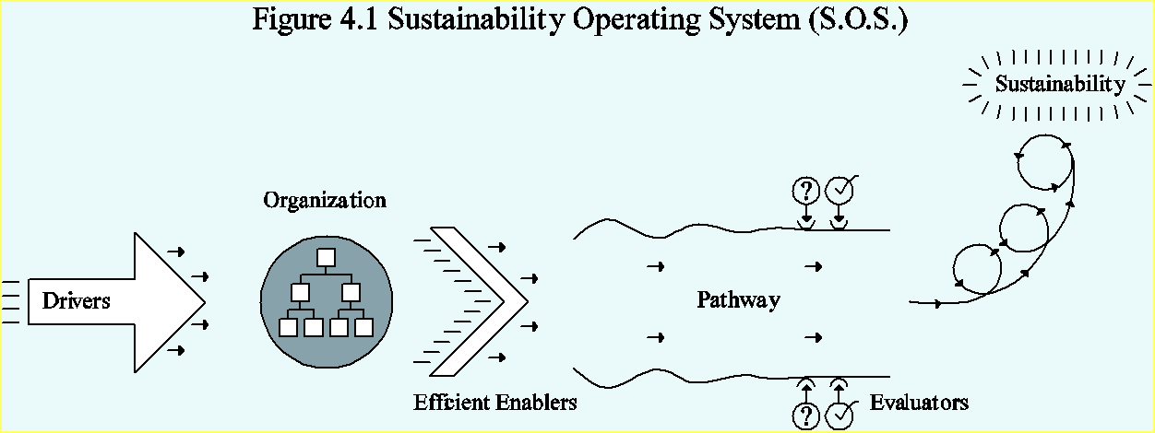
The Drivers | The Efficient Enablers | The Pathway | The Evaluators
©2017 William Blackburn Consulting, Ltd.

Slide 105
The Drivers | The Efficient Enablers | The Pathway | The Evaluators
A champion/leader; visible top management support Approach for selling the organization on sustainability Accountability/reward mechanisms
©2017 William Blackburn Consulting, Ltd.

Slide 106
The Drivers | The Efficient Enablers | The Pathway | The Evaluators
A champion/leader; visible top management support Approach for selling the organization on sustainability Accountability/reward mechanisms | Organizational structure Deployment and integration through workforce & suppliers
©2017 William Blackburn Consulting, Ltd.

Slide 107

Typical Organizational Structure
Champion/leader: spokesperson; key promoter, coordinator, and organizer; chair of key coordinating team
CEO: companywide and external advocate
Executive sponsor: advocate among upper management, coach for leader and teams
Multi-department, multi-functional coordinating team(s):
  Planning, promotion, education
  Rollout and feedback
  Public reporting
Board oversight committee: high level oversight of SOS performance and effectiveness
©2017 William Blackburn Consulting, Ltd.
Notes:
36 CSOs in US in 2014 (Weinreb Group)
40% of US sust depts. Have only 1-5 members; most resources within other functions like EHS
15% Sust function reports to Corp Affairs, 11% to EHS, only 1% to Mfg (2014)
A little over 1/3 have vps leading function, ditto for directors; 1/6 have mgrs.

Slide 108
The Drivers | The Efficient Enablers | The Pathway | The Evaluators
A champion/leader; visible top management support Approach for selling the organization on sustainability Accountability/reward mechanisms | Organizational structure Deployment and integration through workforce & suppliers
©2017 William Blackburn Consulting, Ltd.

Slide 109
Deployment, Integration, Alignment & Accountability
Deployment
  Developing and testing rollout tools
  Field implementation
Integration — building the new into the familiar
©2017 William Blackburn Consulting, Ltd.
Notes:
Clear objectives, transparency on performance, and consequences—rewards and pain

Slide 110
©2017 William Blackburn Consulting, Ltd.

Slide 111
Deployment, Integration, Alignment & Accountability
Deployment
  Developing and testing rollout tools
  Field implementation
Integration — building the new into the familiar
Alignment —balancing organization-wide consistency with cultural accommodation
Accountability —connecting execution with personal objectives (with consequences)
©2017 William Blackburn Consulting, Ltd.
Notes:
Clear objectives, transparency on performance, and consequences—rewards and pain

Slide 112
Why the increased focus on sustainability in supply chains?
Public expectation of corporate buyer’s responsibility for supply chain
Consumer sensitivity to ethical behavior of producers
Extent of environmental and social impact (risk)
NGO focus and reach, global e-communications
Opportunities for greater supply chain efficiency ($)
Buyer’s legal compliance
  SEC conflict minerals; Lacey Act (illegal wood); updated OSHA SDS, DOT
  CA Prop 65 and Transparency in Supply Chains laws;
  EU RoHS, REACH, WEEE, Packaging & Battery laws
Sustainability as a company strategy; search for sustainable products
WHY?
©2017 William Blackburn Consulting, Ltd.
Notes:
Perception of increased risk and opportunity around sustainability in supply chain= good business
300 dead over past 6 years from fires in garment factories in Bangladesh.

Slide 113

Ongoing Sustainability Issues
Supplier issues
  “Living wage”, “training wages”, nonpayment of workers
  Coaching workers on audit responses; bribing auditors
  Excessive hours ( due to customer ordering practices)
  Traceability, hidden noncompliant subcontractors
Company (customer) issues
  Procurement dept. view of little business value vs. cost and time
  Viewing supplier network as low-cost source, not a strategic asset; squeezing costs, slow payment
  Audit fatigue; auditing vs training/coaching around root causes
  Repeat issues; few supplier management systems
©2017 William Blackburn Consulting, Ltd.
Notes:
Traceability: Mattel $100 mil for recall of toys with lead paint obtained from tier-two supplier

Slide 114
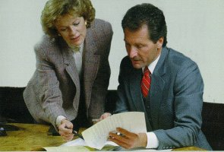
Common Program Elements for Responsible Supply Chains
1. Oversight structure
2. Supplier mapping, prioritization
©2017 William Blackburn Consulting, Ltd.

Slide 115

Risk Based Approach:
Prioritizing Suppliers
Spend
Hazard/risk of product, service
Product scrutiny (e.g., medicines, food, children’s products)
Historical performance (e.g., toys in China, garments in SE Asia)
Regulatory coverage (e.g., medical & food products, chemicals, packaging & electronics)
Importance of supply; availability of alternative sourcing
©2017 William Blackburn Consulting, Ltd.
Notes:
Importance of supply, e.g., Lithium from Bolivia for battery manufacturer

Slide 116
Common Program Elements for Responsible Supply Chains
1. Oversight structure
2. Supplier mapping, prioritization
3. Supplier standards, Codes of Conduct
©2017 William Blackburn Consulting, Ltd.

Slide 117
Sustainability Topics that Stakeholders
Expect Companies to Address*
Governance (oversight structures and systems for legal and ethical compliance and risk control on below topics for organization and its supply chain)
Human Rights (civil rights, nondiscrimination, etc.)
Labor Practices (wages, working conditions, etc.)
Environmental Issues (pollution, energy and resource conservation, biodiversity, etc.)
Fair Operating Practices (anti-corruption, fair competition, etc.)
Consumer/customer Issues (fair marketing, consumer safety, product compliance, etc.)
Community Involvement & Development
Economic Viability of the Organization (GRI only)
*Based on the GRI reporting guidelines and ISO 26000 SR standard
©2012 William Blackburn Consulting, Ltd.
©2017 William Blackburn Consulting, Ltd.

Slide 118
Topics Covered by
Supplier Codes of Conduct
M=McDonald’s Supplier Code of Conduct
NE=Nestle Supplier Code
N=Nike Code of Conduct (for Contract Factories)
NN=Novo Nordisk Responsible Sourcing Standards for Business Partners
W=Wal-Mart Standards for Suppliers
Audit & Assessment: M, NN
Compliance with Law: M, NE, N, NN, W
Ethics, Anti-corruption: M, NE, NN, W
Human Rights, Nondiscrimination: M, NE, N, NN
Labor Practices, Working Conditions: M, NE, N, NN, W
Health & Safety: M, NE, N, NN, W
Environment: M, NE, N, NN, W
Recordkeeping: M, NE, W
Sub-supplier Code Compliance: NE, N, NN
©2017 William Blackburn Consulting, Ltd.

Slide 119
Common Program Elements for Responsible Supply Chains
4. Evaluation process
a. Questionnaires, surveys, e.g.:
GeSI & EICC (electronics cos.)
Pharmaceutical Supply Chain Initiative (medical cos.)
b. Self-assessments
c. Audits, facility certifications (e.g., SA8000, WRAP, ISO 14001)
d. Data systems, indexes (e.g., Wal-Mart, Timberland, Nike)
e. Shared data systems
©2017 William Blackburn Consulting, Ltd.

Slide 120
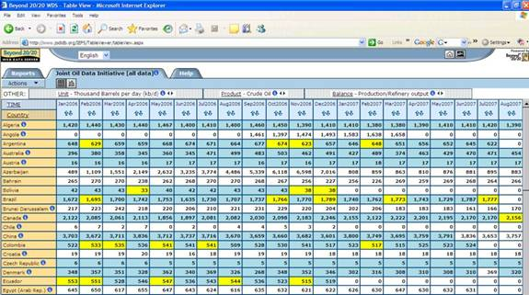
Shared Supplier Databases
Better Work Program (IFC & ILO): Wal-Mart, Nike, Target, Levi’s, et al.
Fair Factories Clearinghouse: Wal-Mart, Nike, Adidas, Levi’s, Starbucks, Burberry, et al.
Global Data Synchronization Network (GS1): Wal-Mart and other retail companies, healthcare and other sectors
Fair Labor Association: Nestle, Apple, Adidas, Dallas Cowboys, Duke, Arizona State, Columbia U., et al.
Suppliers Ethical Data Exchange (Sedex) (London): Nestle, Unilever, P&G, The Body Shop, Tesco, PepsiCo, Kraft, British, et al.
Business Social Compliance Initiative (European Foreign Trade Assn.): European retail, brand, and importing companies
Ecovadis (Paris): Bayer, Heineken, J&J, Michelin, Verizon, et al.
©2017 William Blackburn Consulting, Ltd.
Notes:
International Finance Corporation, affiliated with the World Bank

Slide 121
Common Program Elements for Responsible Supply Chains
5. Goals, metrics
Link with co. sustainability goals
Compliance with standards, certifications
6. Tracking and reporting performance vs. goals, standards, law; Traceability
©2017 William Blackburn Consulting, Ltd.

Slide 122
Traceability
2014 U.N. Global Compact and BSR Study:
Many company-specific traceability schemes fail because:
  Some suppliers or their agents or distributors are reluctant to share data (although can use “blind” sharing systems); or
  A large number of small producers prove difficult to track.
2. Success is easier in global collaborative traceability schemes, such as:
  Better Cotton Initiative
  Forest Stewardship Council
  Marine Stewardship Council
  Roundtable for Sustainable Palm Oil
  Fairtrade Labelling Organization
©2017 William Blackburn Consulting, Ltd.
Notes:
GS1’s Global Data Synchronization Network can provide secure data.

Slide 123
Common Program Elements for Responsible Supply Chains
7. Training, Communication and Engagement
Guidance book
Website, online training
Newsletters
Conferences
Model facilities (e.g., Marks & Spencer)
©2017 William Blackburn Consulting, Ltd.

Slide 124
Common Program Elements for Responsible Supply Chains
8. Supplier Management Systems (e.g., ISO 14001, SA 8000,EICC)
9. Supplier Awards (Wal-Mart, McDonald’s, AT&T, Bombardier), Other Motivators
©2017 William Blackburn Consulting, Ltd.

Slide 125

Motivating Suppliers
More business
Greater access to customer, further assistance
Improved productivity, efficiency, performance
Rewards and recognition
©2017 William Blackburn Consulting, Ltd.
Notes:
Allow suppliers to be more like partners

Slide 126
Common Program Elements for Responsible Supply Chains
7. Training, Communication and Engagement
Guidance book
Website, online training
Newsletters
Conferences
Model facilities
8. Supplier Management Systems (e.g., ISO 14001, SA 8000)
9. Supplier Awards, Other Motivators
10. Collaborative Programs
©2017 William Blackburn Consulting, Ltd.

Slide 127
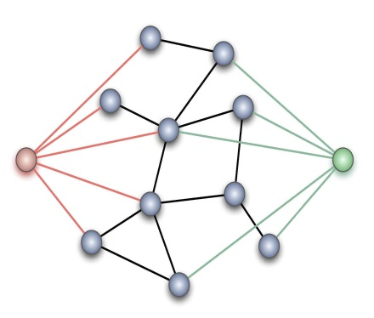
Responsible Sourcing Networks
The Sustainability Consortium: Wal-Mart, J&J, McDonald’s, P&G, General Mills, et al., plus NGOs and academics
Global Social Compliance Programme Task Force: Wal-Mart, IKEA, Unilever, Best Buy, et al.
AIM Progress: McDonald’s, Unilever, Coca Cola, General Mills, AB InBev, et al.
Ethical Trading Initiative: European companies, unions, NGOs
Electronic Industry Citizenship Coalition (EICC)
Global e-Sustainability Initiative
GS1 Sustainability Workgroup
Beyond Monitoring Working Group (BSR)
Pharmaceutical Supply Chain Initiative (BSR): Baxter, et al.
©2017 William Blackburn Consulting, Ltd.
Notes:
FLA: Subscribers sign on to FLA code on working conditions; monitoring, remediation and verification process

Slide 128
Other Responsible Sourcing Resources
Company websites and collaborative programs
Business for Social Responsibility (BSR) Center for Sustainable Procurement
CERES
Green Supplier Network (U.S. EPA and U.S. Dept. of Commerce)
Sustainable Supply Chain Resources & Practices/ Portal for Responsible Supply Chain Management (U.N. Global Compact and CSR Europe)
United Nations Environment Programme (UNEP) Supply Chain Management
Social Accountability International (SA8000 standard certifications)
Worldwide Responsible Accredited Production (certifications to WRAP Principles for apparel industry)
©2017 William Blackburn Consulting, Ltd.
Notes:
FLA: Subscribers sign on to FLA code on working conditions; monitoring, remediation and verification process

Slide 129
The Drivers | The Efficient Enablers | The Pathway | The Evaluators
A champion/leader; visible top management support Approach for selling the organization on sustainability Accountability/reward mechanisms | Organizational structure Deployment and integration through workforce & suppliers | Vision and policy Operating system standards Strategic planning for aligned priorities
©2017 William Blackburn Consulting, Ltd.

Slide 130
Good Sources of Sustainability Policies
UN Global Compact
  Most popular
  Omits economic component, though
Conference Board model policy
Bristol-Meyers Squibb
©2017 William Blackburn Consulting, Ltd.

Slide 131
Bristol-Meyers Squibb Sustainability Policy
Our Commitment
To our patients and customers, employees, global communities, shareholders, environment and other stakeholders, we promise to act on our belief that the priceless ingredient of every product is the integrity of its maker. We operate with effective governance and high standards of ethical behavior. We seek transparency and dialogue with our stakeholders to improve our understanding of their needs. We take our commitment to economic, social and environmental sustainability seriously, and extend this expectation to our partners and suppliers.

Slide 132
Bristol-Meyers Squibb Sustainability Policy
Our Commitment
2. To our patients and customers--
We commit to scientific excellence and investment in biopharmaceutical research and development to provide innovative, high-quality medicines that address the unmet medical needs of patients with serious diseases. We apply scientific rigor to produce clinical and economic benefit through medicines that improve patients’ lives. We strive to make information about our commercialized medicines widely and readily available.

Slide 133
Bristol-Meyers Squibb Sustainability Policy
Our Commitment
3. To our employees--
We embrace a diverse workforce and inclusive culture. The health, safety, professional development, work-life balance and equitable, respectful treatment of our employees are among our highest priorities.
4. To our global communities--
We promote conscientious citizenship that improves health and promotes sustainability in our communities.

Slide 134
Bristol-Meyers Squibb Sustainability Policy
Our Commitment
5. To our shareholders--
We strive to produce sustained strong performance and shareholder value.
6. To our environment--
We encourage the preservation of natural resources and strive to minimize the environmental impact of our operations and products.

Slide 135
The Drivers | The Efficient Enablers | The Pathway | The Evaluators
A champion/leader; visible top management support Approach for selling the organization on sustainability Accountability/reward mechanisms | Organizational structure Deployment and integration through workforce & suppliers | Vision and policy Operating system standards Strategic planning for aligned priorities
©2017 William Blackburn Consulting, Ltd.

Slide 136
©2017 William Blackburn Consulting, Ltd..

Slide 137
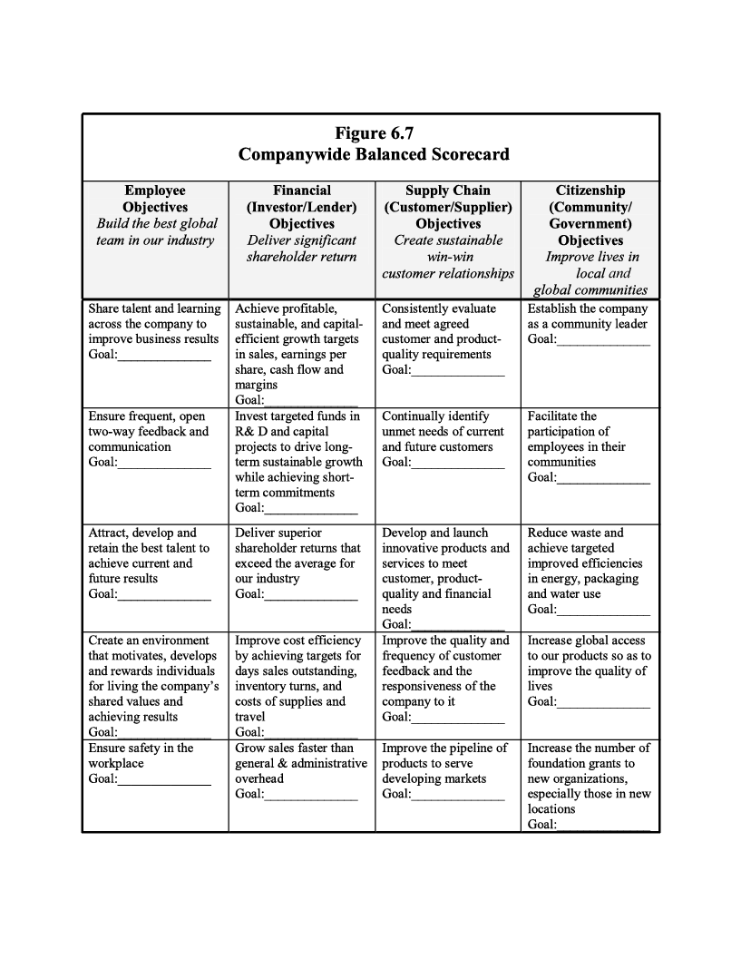
©2017 William Blackburn Consulting, Ltd..

Slide 138
The Drivers | The Efficient Enablers | The Pathway | The Evaluators
A champion/leader; visible top management support Approach for selling the organization on sustainability Accountability/reward mechanisms | Organizational structure Deployment and integration through workforce & suppliers | Vision and policy Operating system standards Strategic planning for aligned priorities | Indicators and goals Measuring and reporting progress Stakeholder engagement and feedback
©2017 William Blackburn Consulting, Ltd.

Slide 139
Continual Improvement Cycle
(Operating or Management System)
(For sustainable quantum leap in performance)
Collect Data to
Measure Performance
Implement
Plan
Identify Strengths
and Gaps
Plan Priorities for
Addressing Gaps
Report Data
Solicit Stakeholder
Feedback
©2017 William Blackburn Consulting, Ltd.

Slide 140
Sustainable Products & Services
Improve the efficient use of natural and economic resources along the product life cycle
Provide greater respect and accommodation for the needs of people and other living things along the product life cycle
©2017 William Blackburn Consulting, Ltd.

Slide 141
Life Cycle of a Product
©2017 William Blackburn Consulting, Ltd.

Slide 142

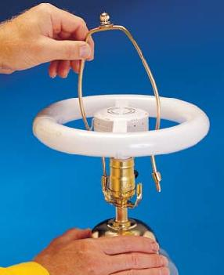
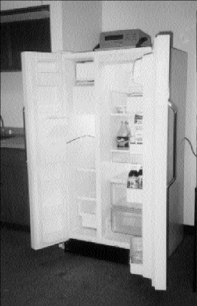
Not Every “Green” Product is Successful…
©2017 William Blackburn Consulting, Ltd.
Notes:
Thomas Edison electric car
Whirlpool Super Efficient Refrigerator Project (SERP); won $35 mil prize for eliminating Freon and improving energy efficiency, but size and pricing were wrong.

Slide 143
7 Lessons on Sustainable
Products & Services
Customers will pay more for added safety of food and hygiene- and health-related products, and for a more natural living environment; some will pay more for lower life-cycle costs.
Products and services for the poor must break barriers on cost/pricing either through low volume per unit, use sharing, or low-cost operations.
Government mandate can create markets for green products and services.
©2017 William Blackburn Consulting, Ltd.
Notes:
3. Energy Star computers; green energy

Slide 144


7 Lessons on Sustainable
Products & Services
A small percentage of customers will pay more for a green product or service than a comparable non-green product purely for ethical reasons.
Some customers will avoid products with a highly publicized social or environmental stigma as well as products from companies with such a stigma.
©2017 William Blackburn Consulting, Ltd.
Notes:
3. Energy star computers; green energy

Slide 145

7 Lessons on Sustainable
Products & Services
Some commercial customers will pay more for green products if they can gain a clear reputational advantage with their own customers or other important stakeholders.
With those exceptions, a product’s social and environmental advantages and cause-based marketing are differentiating factors, not primary factors, to most consumers.
©2017 William Blackburn Consulting, Ltd.

Slide 146
One Key To Success:
Knowing Market Segments
Dedicated Greens/ “Lifestyles of Health & Sustainability” (LOHAS) -- 8-20%
Sympathetic, Pragmatic, Health & Wellness Greens – 25-35%
Overwhelmed/ Procrastinators – 15-25%
Unconcerned/ Other Priorities – 15-35%
Survey Sources: -Roper
-National Marketing Institute
-Hartman Group
-Landor Associates
Greener
©2017 William Blackburn Consulting, Ltd.

Slide 147
Part IV. Design of Sustainable/Green Products and Services
©2017 George P. Nassos & Associates, Inc.

Slide 148
Adopt Sustainable Strategies
Eco-effective vs. Eco-efficient
The Natural Step (and its four system conditions)
Servicizing
Biomimicry
            © George P. Nassos & Associates, Inc.

Slide 149
Adopt Sustainable Strategies
5. Base of the Pyramid
6. Systems Thinking & Tunneling
7. Sustaining Fisheries
8. Green Buildings
9. “Big Hairy Audacious Goal”
©2017 George P. Nassos & Associates, Inc.

Slide 150
Think About This!
While you are learning about sustainability design strategies, think about how you can apply one or more of these to:
  Your place of work
  Some other company
  A new company that you would like to form.
©2017 George P. Nassos & Associates, Inc.

Slide 151
1. Eco-efficient or Eco-effective
Fuel efficiency
Computing efficiency
More durable brake pads
2017 George P. Nassos & Associates, Inc.

Slide 152
More Efficient Products
Clocks & Watches
Leveraging Electrical Demand
.
©2017 George P. Nassos & Associates, Inc.

Slide 153
2. The Natural Step
Founded by Karl-Henrik Robért
Developed four system conditions
©2017 George P. Nassos & Associates, Inc.

Slide 154
Condition No. 1
Do not systematically increase concentration of substances extracted from the Earth’s crust
  Do not remove fossil fuels, metals, minerals faster than reintegration
  Concentrations would increase in ecosphere
©2017 George P. Nassos & Associates, Inc.

Slide 155
Condition No. 2
Do not systematically increase concentrations of substances produced by society
  Similar to first condition (synthetically produced)
  Same impact if neglected
  .
©2017 George P. Nassos & Associates, Inc.

Slide 156
Condition No. 3
Do not systematically mismanage the ecosphere
  Do not over-harvest fertile areas, soils, fresh water
  Do not diminish availability of natural systems
©2017 George P. Nassos & Associates, Inc.

Slide 157
Condition No. 4
Resources are used fairly and efficiently in order to meet basic human needs worldwide
  Must use most resource-efficient methods possible
  Necessary condition if first three are met
©2017 George P. Nassos & Associates, Inc.

Slide 158
Companies Employing The Natural Step
IKEA
Interface
Starbucks
Nike
©2017 George P. Nassos & Associates, Inc.

Slide 159
3. Extended Producer Responsibility/ Product Stewardship
Minimizing adverse effects
Take-back responsibility
Hazard information
Assumption of liability
©2017 George P. Nassos & Associates, Inc.

Slide 160
Servicizing
Redefine commerce to deliver service and value, not material
Maintain control over product life cycle
Produce more cost efficient products
©2017 George P. Nassos & Associates, Inc.

Slide 161
Some Servicizing Strategies
Product miniaturization
Multipurpose products
Leasing
Replacing service product with service
©2017 George P. Nassos & Associates, Inc.

Slide 162
Application of Servicizing Strategy
Incandescent Light Bulbs
Interface – Commercial Carpeting
Electrolux – Washing Machines
DuPont & Ford – Auto Assembly Paint Shop
Volvo – Transportation Company
©2017 George P. Nassos & Associates, Inc.

Slide 163
Biomimicry
Biomimicry has been around for thousands of years…… and it still works.
Do you have any ideas of learning from nature?
©2017 George P. Nassos & Associates, Inc.

Slide 164
4. Learn From Nature – Biomimicry
Abalone
©2017 George P. Nassos & Associates, Inc.

Slide 165
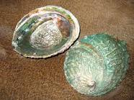
Abalone Shells – Stronger than Ceramics
©2017 George P. Nassos & Associates, Inc.

Slide 166

Spider Silk – Stronger than Steel, Tougher than Kevlar
©2017 George P. Nassos & Associates, Inc.

Slide 167
Learn From Nature – Biomimicry
Cow enzyme production
Mobile phone screen
©2017 George P. Nassos & Associates, Inc.

Slide 168
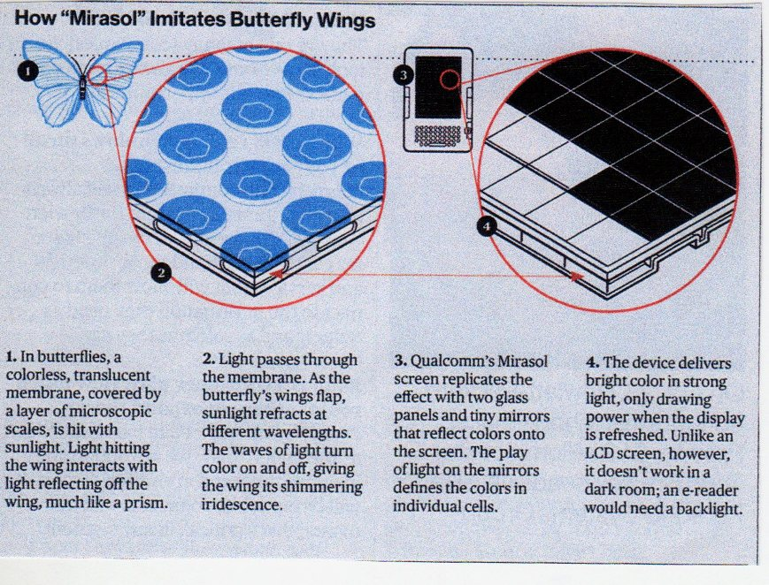
Read Mobile Phone Screen in the Sun
©2017 George P. Nassos & Associates, Inc.

Slide 169
Paper from Wood
In 1600s, shortage of paper. Valuable commodity in short supply. What was it?
Rags
Scientist walks through a forest.
©2017 George P. Nassos & Associates, Inc.

Slide 170
©2017 George P. Nassos & Associates, Inc.

Slide 171
©2017 George P. Nassos & Associates, Inc.

Slide 172
©2017 George P. Nassos & Associates, Inc.

Slide 173
©2017 George P. Nassos & Associates, Inc.

Slide 174
©2017 George P. Nassos & Associates, Inc.

Slide 175
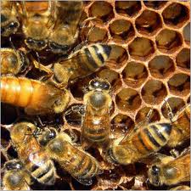
Bee Hive – Hexagonal Home Built by Bee Engineers
©2017 George P. Nassos & Associates, Inc.

Slide 176
5. The Global Pyramid
Annual Purchasing Power
Population in Millions
>$15,000
1,000
Wealth by Emerging Middle Class
$1,500 – 15,000
1,700
<$1,500
Low-Income Markets
(BOP)
4,200
©2017 George P. Nassos & Associates, Inc.

Slide 177
The Great Leap Downward
Bottom of the Top
Base of the Pyramid
©2017 George P. Nassos & Associates, Inc.

Slide 178
Driving Innovation from the
Base of the Pyramid
Honda
Unilever
Galanz
Nike
©2017 George P. Nassos & Associates, Inc.

Slide 179
Nike Applies BOP Strategy
World Shoe Project
China – manufacturer and market
Competition from Li Ning
Success?
©2017 George P. Nassos & Associates, Inc.

Slide 180
6. Components of System Thinking
Elements
Interconnections
Purpose or Goal
©2017 George P. Nassos & Associates, Inc.

Slide 181
Tunneling Through the Cost Barrier
Typical: Diminishing Returns
©2017 George P. Nassos & Associates, Inc.

Slide 182
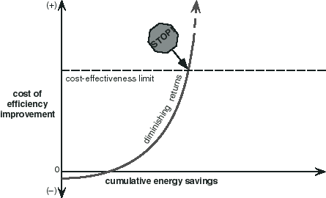
©2017 George P. Nassos & Associates, Inc.

Slide 183
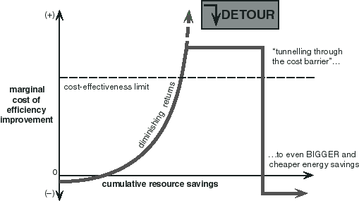
©2017 George P. Nassos & Associates, Inc.

Slide 184
Tunneling Through the Cost Barrier
Typical: Diminishing Returns
Different Possibility: Whole System
Straight Pipes
Insulation and Thermopane
Immigration
©2017 George P. Nassos & Associates, Inc.

Slide 185
7. Sustaining U.S. Fisheries
90% fully fished or overfished
1,414 species (5%) face extinction
  No. 1 – Bluefin Tuna
Per capita annual consumption
  1960s – 22 pounds
  Now – 44 pounds
Over 72,000 jobs lost
Typical fisherman earns 30% less
©2017 George P. Nassos & Associates, Inc.

Slide 186
Introduce “Catch Shares”
Innovative, incentive-based tool
“Limited Access Privilege Programs” (LAPPS)
Simultaneously
  Protect environment
  Increase profits
  Higher quality fish
  Create more full-time jobs
©2017 George P. Nassos & Associates, Inc.

Slide 187
Management of Catch Shares
Determine annual catch
Allocate annual catch to fishermen
Enforce the regulation
©2017 George P. Nassos & Associates, Inc.

Slide 188
Benefits of Catch Shares
1. Employs better science and monitoring
2. Reduce bycatch
3. Limit fishing impacts on habitats
4. Safer fishing
5. Improving economic performance
©2017 George P. Nassos & Associates, Inc.

Slide 189
8. What is a green building?
Increasing efficiency
  Energy
  Water
  Materials
Reducing building impacts on
  Human health
  Environment
©2017 George P. Nassos & Associates, Inc.

Slide 190
Projects Earn Points
Integrative process
Location and transportation
Sustainable sites
Water efficiency
Energy and atmosphere
Materials and resources
Indoor environmental quality
Innovation
Regional priority
©2016 George P. Nassos & Associates, Inc.

Slide 191
Point System for All Projects
Certified: 40 – 49
Silver: 50 – 59
Gold: 60 – 79
Platinum: 80+
Additional bonus of 10 points
©2017 George P. Nassos & Associates, Inc.

Slide 192
LEED 4.0 Benefits
Flexibility with strategy
Performance based approach
Smart grid thinking
More comprehensive approach to water
Expanded focus on materials
Streamlined documentation
©2017 George P. Nassos & Associates, Inc.

Slide 193
Human & Social Benefits
Day lighting improved test scores
Higher sales with sky lights
Increased productivity
Reduced respiratory diseases
©2017 George P. Nassos & Associates, Inc.

Slide 194
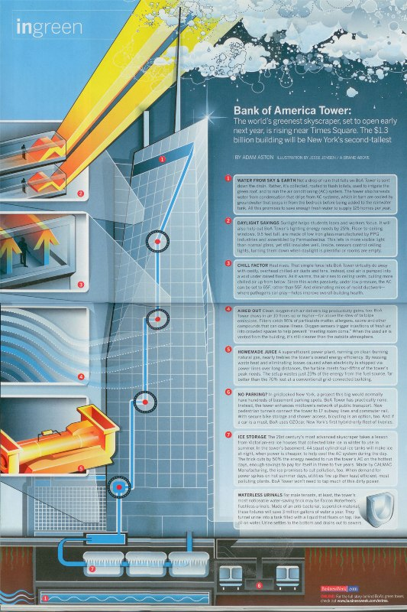

Slide 195
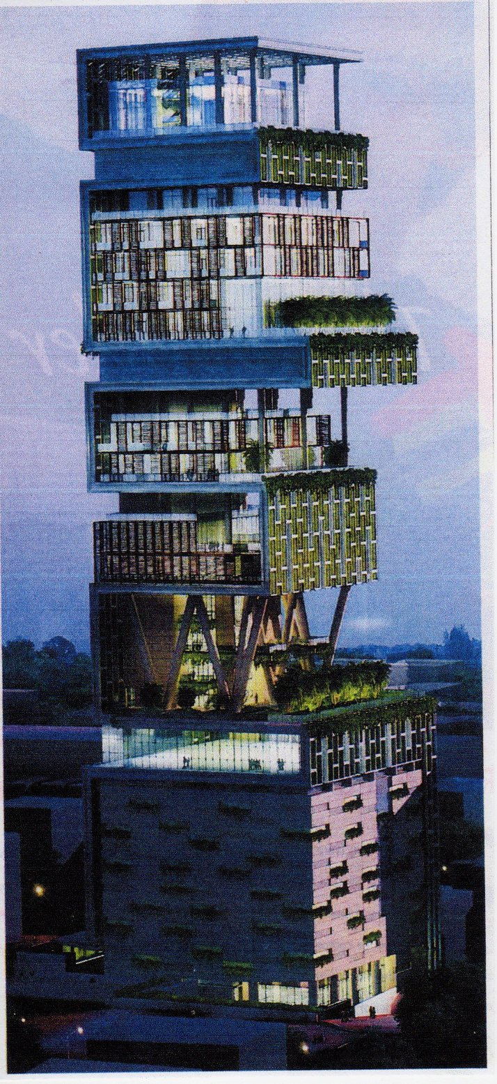
Certainly Not LEED Certified
©2017 George P. Nassos & Associates, Inc.

Slide 196
Certification Trend
1% of Non-Residential Buildings certified
3.8% based on area are certified
Certification of existing buildings – 0.01%
540 applications in 2016 – 4,000 per year previous 10 years
LEEDership recommends
  Cut carbon emissions
  More healthy buildings
  Cut certification time 90-99% -- one week
  Use cloud based analytics
©2017 George P. Nassos & Associates, Inc.

Slide 197
9. “Big Hairy Audacious Goal”
Washing machines
Toilets
©2017 George P. Nassos & Associates, Inc.

Slide 198
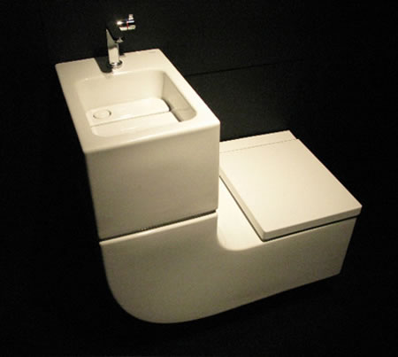

Toilet Lid Sink
©2017 George P. Nassos & Associates, Inc.

Slide 199

Sink Above Urinal
©2017 George P. Nassos & Associates, Inc.

Slide 200
9. “Big Hairy Audacious Goal”
Washing machines
Toilets
Farming
©2017 George P. Nassos & Associates, Inc.

Slide 201
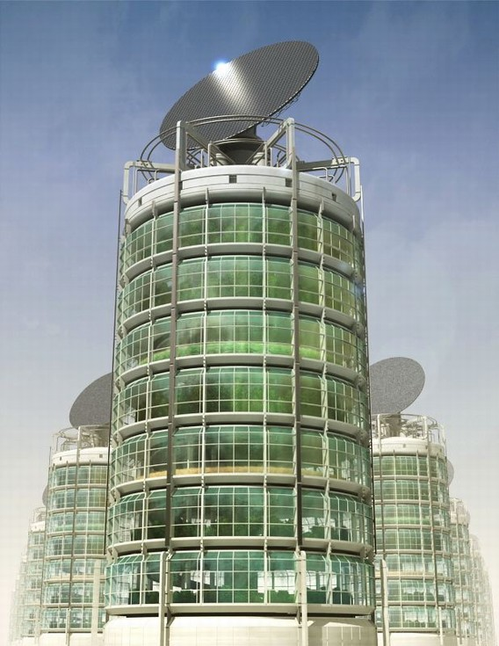
Vertical Farm
©2017 George P. Nassos & Associates, Inc.

Slide 202
Advantages of Vertical Farming
Year-around crop production
No weather problems
All food grown organically
Eliminates agricultural runoff
Farming in urban centers
Reduces fossil fuel use
Converts black and gray water
©2017 George P. Nassos & Associates, Inc.

Slide 203
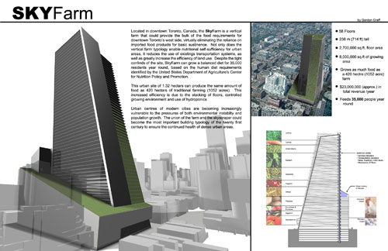

Slide 204
How About Vertical Farm & LEED?
Association for Vertical Farming
Develop metrics for rating
  Energy usage
  Water usage
  Laborers
  Grow area vs. building footprint
  Distance from market
  Another 15-20 metrics
©2017 George P. Nassos & Associates, Inc.

Slide 205
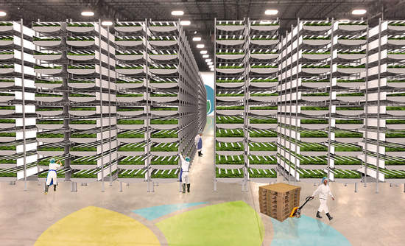
AreoFarms – Newark, NJ
©2017 George P. Nassos & Associates, Inc.

Slide 206
AeroFarms – NJ
Former indoor arena
70,000 sq. ft.
Uses 95% less water
No soil
Grow cycle: 12-16 days, not 30-45
Will grow two million pounds of greens per year
Will be world’s largest vertical farm
©2017 George P. Nassos & Associates, Inc.

Slide 207
Chicago Area Vertical Farms
Farmed Here – Bedford Pk
SkyyGreens – 1400 W. 46th
Gary Comer Youth Center –
7200 S. Ingelside
Uncommon Ground – 1400 W. Devon
Urban Ponics – 500 W. Cermak
©2017 George P. Nassos & Associates, Inc.

Slide 208
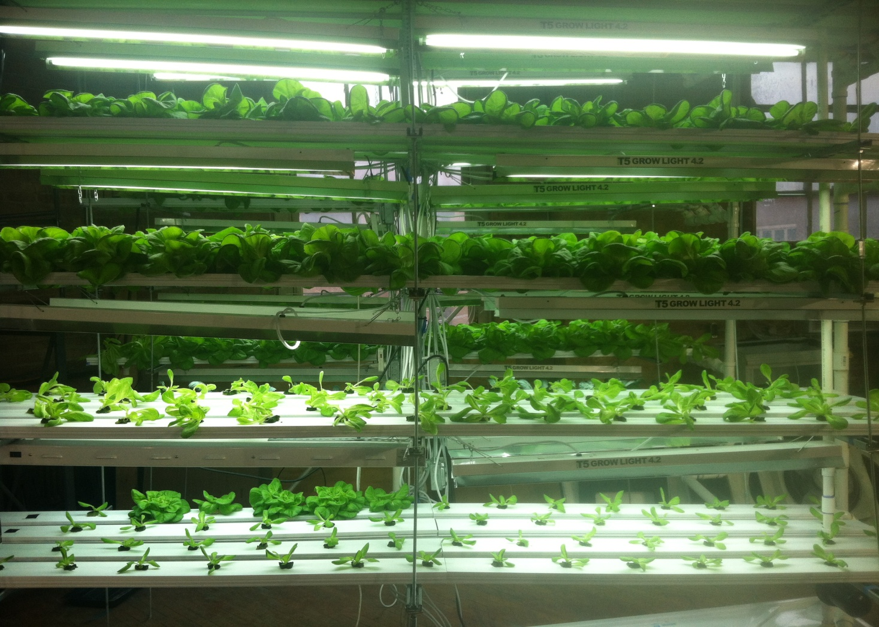
Urban Ponics – Chicago
©2017 George P. Nassos & Associates, Inc.

Slide 209
Some Other Sustainability Solutions/Strategies
Sharing Economy
Circular Economy
Adaptation and Resiliency
©2017 George P. Nassos & Associates, Inc.

Slide 210
The Sharing Economy
Underutilized assets
  Time
  Objects
  Physical spaces
Resource efficiency
Flexibility and independence for workers
©2017 George P. Nassos & Associates, Inc.

Slide 211
The Sharing Economy – Disadvantages?
May not offer steady income
Health insurance?
Sick pay?
Longer hours for less pay
Impact on typical businesses?
©2017 George P. Nassos & Associates, Inc.

Slide 212
Examples of Sharing Economy
Phone Ladies
Zipcar/ Whipcar/ Buzzcar/ RelayRides
Parkatmyhouse
Airbnb/Couch Share
Yerdle
Munchery
ClosetDashShop
WeTeachMe
OhSoWe
Better Place
©2017 George P. Nassos & Associates, Inc.

Slide 213
The Circular Economy
Cradle to Cradle – also known as
  Eco Design
  Industrial Ecology
©2017 George P. Nassos & Associates, Inc.

Slide 214
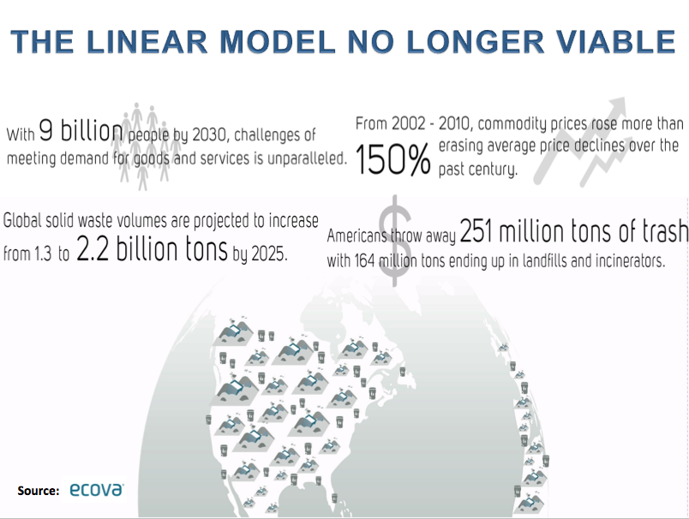

Source:

Slide 215
Examples of Circular Economy
Phillips
Vodafone
H&M
Trina
Ricoh
Other Opportunities
Remanufacturing phones
Lease washing machines
Reuse of food
©2017 George P. Nassos & Associates, Inc.

Slide 216
What is Adaptation?
Human efforts to reduce negative effects
Changes in social-ecological systems
Insurance – create resiliency
©2017 George P. Nassos & Associates, Inc.

Slide 217
Your Thoughts?
How can you apply one or more of these design strategies at--
  Your place of work
  Some other company
  A new company that you would like to form.

Slide 218
Part V: Prioritizing, Planning, Communicating

Slide 219
Materiality, Prioritization
Materiality: Generally, what is most important, typically for determining what to act on (planning) and report
Key Materiality Reporting Standards:
U.S. Securities & Exchange Comm.(SEC)
Sustainability Accounting Standards Bd. (SASB)
International Integrated Reporting Cncl. (IIRC)
Global Reporting Initiative (GRI)
©2017 William Blackburn Consulting, Ltd..

Slide 220
Materiality, Prioritization
Materiality: Generally, what is most important, typically for determining what to act on (planning) and report
Stakeholder Perspective:
  GRI: all key stakeholders
  US SEC, SASB and IIRC: investor
©2017 William Blackburn Consulting, Ltd..

Slide 221
Materiality Definitions
SEC, SASB: Whether there is a substantial likelihood that a reasonable investor would consider the information important enough to “alter the total mix of information” he is considering in deciding whether to buy, hold or sell stock or how to vote his shares.
IIRC: Whether the information could substantially affect the assessment of investors with regard to the organization’s ability to create value over the short, medium or long term, in enhancing any of the “six capitals” : Financial, Manufactured, Intellectual, Human, Social & Relationship, and Natural.
©2017 William Blackburn Consulting, Ltd..

Slide 222
Materiality Definitions
GRI: Whether the “aspect” would–
  Reflect the organization’s significant economic, environmental and social impacts, or
  Substantively influence the assessment and decisions of stakeholders (investors, employees, customers, communities, government, et al.) about the organization
©2017 William Blackburn Consulting, Ltd..

Slide 223
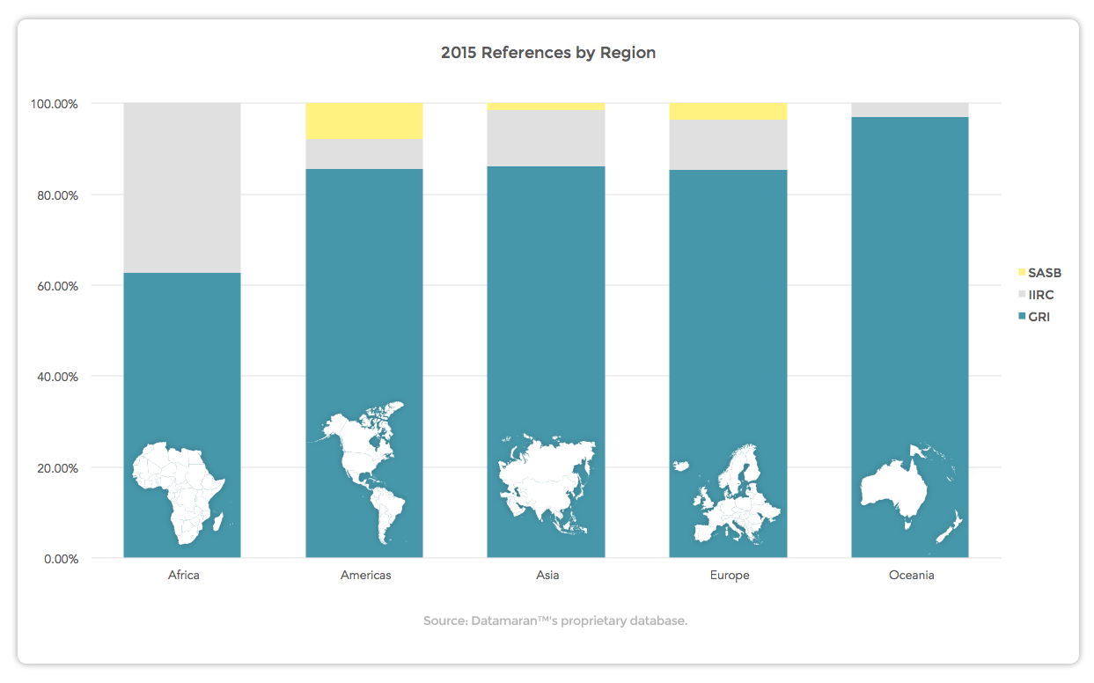

Slide 224
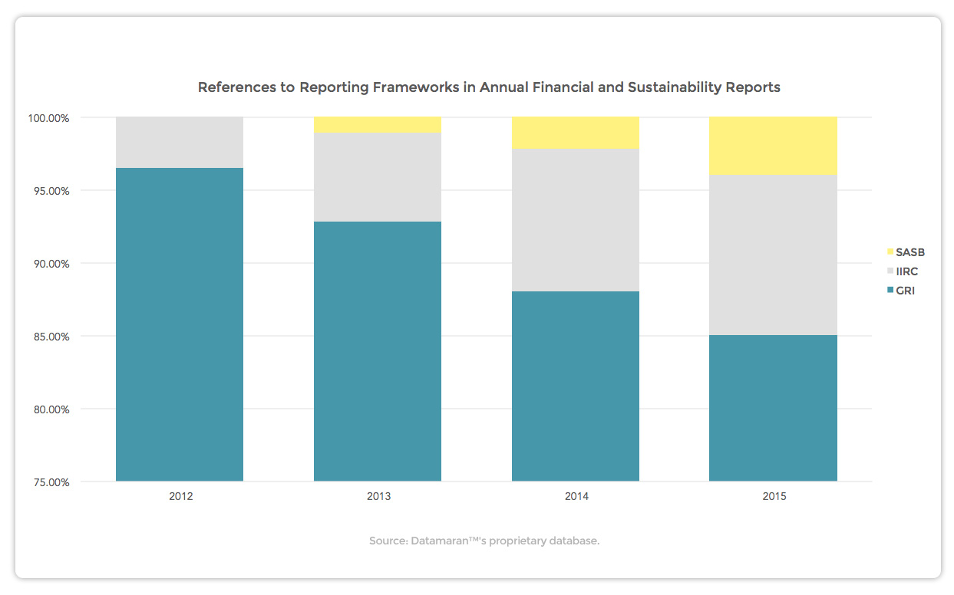

Source: eRevalue Blog: “The Battle of Giants: GRI vs SASB vs IR” citing Datamaran database., Mar. 1, 2016

Slide 225
Materiality Definitions
GRI: Whether the “aspect” would–
  Reflect the organization’s significant economic, environmental and social impacts, or
  Substantively influence the assessment and decisions of stakeholders (investors, employees, customers, communities, government, et al.) about the organization
©2017 William Blackburn Consulting, Ltd..

Slide 226
GRI G4 Aspects
Economic | Environmental
Economic Performance Market Presence Indirect Economic Impacts Procurement Practices | Materials Energy Water Biodiversity Emissions Effluents and Waste Products and Services Compliance Transport Overall Supplier Environmental Assessment Environmental Grievance Mechanisms

Slide 227
GRI G4 Aspects
SOCIAL
Labor Practices & Decent Work | Human Rights | Society | Product Responsibility
Employment Labor/Management Relations Occupational Health and Safety Training and Education Diversity and Equal Opportunity Equal Remuneration for Women and Men Supplier Assessment for Labor Practices Labor Practices Grievance Mechanisms | Investment Non-discrimination Freedom of Association and Collective Bargaining Child Labor Forced or Compulsory Labor Security Practices Indigenous Rights Assessment Supplier Human Rights Assessment Human Rights Grievance Mechanisms | Local Communities Anti-corruption Public Policy Anti-competitive Behavior Compliance Supplier Assessment for Impacts on Society Grievance Mechanisms for Impacts on Society | Customer Health and Safety Product and Service Labeling Marketing Communications Customer Privacy Compliance

Slide 228
Table 1. Sample G4 Aspects
Materiality Evaluation
Rating Scale
0= Lowest Rating, Not Important
5=Top Rating, Very Important
Aspect | Rating of Stakeholder Actual or Potential Concern |  |  |  |  | Rating of Soc., Env., Econ. Impact |  | Materiality Rank H=high M=medium L=low
 | (1) Mgmt | (2) Empl’ee | (3) Custmr | (4) Investor | (5) Pub./ Comm./ Govt./ NGOs | (6) By Org. | (7) By Supply Chain
Economic Perform.
Water
Diversity
Customer Health & Safety
©2017 William Blackburn Consulting, Ltd..

Slide 229
Table 2.
Prioritizing Material Aspects for Action
Rating Scale
0= Lowest Rating, Not Important
5=Top Rating, Very Important
Aspect | Mat. Rank | Rating of Importance to Company |  |  |  |  | Rating of Ease to Impl’mt | Priority Rank H=high M=medium L=low
 |  | Versus strat plan, mgmt views, short-term goals, etc. | Versus culture, values, long-term goals, etc. | Bus. Opportunity (innovation, sales, productivity, reputational, employee rel., license to operate) | Threat Control (legal, fin., reputational, competitive, operational) | Pressure to act, public visibility
Econ. Perform.
Water
Diversity
Customer Health & Safety
©2017 William Blackburn Consulting, Ltd..

Slide 230
Table 3. Action Plan for Select Aspects
Aspect | Priority Rank | Scope of Action to be Taken
 |  | Type of Action (Training, monitoring, reporting, standard-setting, auditing, goal-setting, full program development, etc.) . | Organizational Boundary (Org.-wide, Division A, Facility B, etc.) | Geographic Boundary (Global, Europe, N. America, U.S., China, U.K., etc.) | Time Period of Action
Econ. Perform.
Water
Diversity
Customer Health & Safety
©2017 William Blackburn Consulting, Ltd..

Slide 231
GRI G4 Materiality Matrix
Issue
More Coverage in Report
Issue
Issue
Issue
High
Issue
Issue
Issue
Influence on Stakeholder
Assessments and Decisions
Issue
More Coverage in Report
Issue
Issue
Issue
Issue
Issue
Issue
Low
Issue
Issue
Issue
Issue
Low
High
Significance of Org.’s Economic, Environmental and Social Impacts
©2017 William Blackburn Consulting, Ltd..

Slide 232
What’s Wrong with This?
Issue
More Coverage in Report
Issue
Issue
Issue
High
Issue
Issue
Issue
Influence on Stakeholder
Assessments and Decisions
Issue
More Coverage in Report
Issue
Issue
Issue
Issue
Issue
Issue
Low
Issue
Issue
Issue
Issue
Low
High
Significance of Org.’s Economic, Environmental and Social Impacts
©2017 William Blackburn Consulting, Ltd..

Slide 233
Questions Raised by
Matrix and Materiality Process Reporting?
  Transparency issues:
    Is the “consultant’s process” explained?
    Are issues like diversity, economic performance and product quality ignored because the organization is not comfortable about rating or discussing them?
Stakeholder issues:
  Are ratings based on direct stakeholder feedback or by internal parties acting as surrogates ?
  Which stakeholder groups are concerned about which issues?
  Are all stakeholder groups weighed the same?
  Are all stakeholders within a group weighed the same?
©2017 William Blackburn Consulting, Ltd..

Slide 234
Questions Raised by
Matrix and Materiality Process Reporting?
Impact issues:
  How are the organization’s impacts determined?
  Are the impacts local, regional, national, or global?
  Are impacts in the supply chain considered?
  Are impacts to the org. used in stead of impacts by the org.?
©2017 William Blackburn Consulting, Ltd..

Slide 235

Interesting Example of GRI-G4-like Approach:
  The Co-operative Group (bank, pharmacy, travel agent, grocery, etc.; UK)
“Whilst many businesses produce materiality matrices, our 20 years’ experience of delivering and reporting on sustainability has led us to conclude that approach is not appropriate for us. The range and complexity of inputs to any particular issue make it, at times, overly simplified and detached from the daily reality of evaluating and responding to ethical and sustainability challenges… As such, we feel that a more honest approach is to detail the range of inputs and then detail the material importance of each issue in the relevant report sections.”
©2017 William Blackburn Consulting, Ltd.

Slide 236
Observations about Materiality Process & Reporting
Reporting, prompted by GRI G4 (2013), often leaves gaps, questions about process
Process is rapidly evolving among and within companies
Few companies do this the same way
Some meld materiality and prioritization processes
©2017 William Blackburn Consulting, Ltd..

Slide 237
Stakeholders
---A Focus in Materiality/Prioritization and Reporting Processes
©2017 William Blackburn Consulting, Ltd..

Slide 238
Business Needs the Loyalty of Key Stakeholders to Be Successful
Other
Companies
Investors
Our
Company
Government
Communities
Customers
Rating
Groups
Activists
General
Public
©2017 William Blackburn Consulting, Ltd.
Notes:
Carbon Disclosure Project

Slide 239
Building Stakeholder Loyalty
Transparency
Credibility
Stakeholder
Loyalty
Stakeholder
Engagement
Econ, Env, Soc
Performance
©2017 William Blackburn Consulting, Ltd..
Notes:
Strategic communications (reporting; engagement); no “greenwash”
Working in the “discomfort zone” on the toughest issues
“See ourselves as others see us”

Slide 240
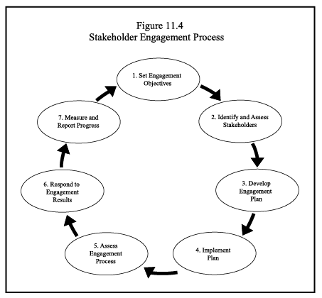
©2017 William Blackburn Consulting, Ltd..

Slide 241
Some Stakeholder Engagement Techniques
Informing stakeholders with no dialogue ( Articles, reports, brochures, interviews, videos etc.)
Informing stakeholders with some dialogue (Site visits, tours, open houses, etc.)
Feedback by stakeholders with no or very little exchange with company (Surveys, feedback cards, hotlines, etc.)
Feedback by stakeholders with some exchange with company (Email and chat-room exchanges)
©2017 William Blackburn Consulting, Ltd.

Slide 242
Some Stakeholder Engagement Techniques
Short-term feedback with extensive exchanges (Focus groups, hearings, conference calls, etc.)
Long-term feedback with extensive exchange (Advisory groups, liaison officers, periodic one-on-one exchanges, etc.)
7. Collaborative identification of issues and design of solutions (Working groups, stakeholder auditors, etc.)
©2017 William Blackburn Consulting, Ltd.

Slide 243
Input for Materiality Process & Reporting
Common information sources:
  Direct stakeholder feedback, surveys, focus groups, direct discussions
  Stakeholder advisory panel
  Organization’s own boards, committees
  Benchmarking studies
  Company plans, policies, codes, goals, key indicators
  Industry-specific standards (GRI sector supplm’t, etc.)
  Socially responsible investor surveys (DJSI, et al.), resolutions, analyst reports
  Emerging legislation
  Complaint and claim logs
  Google search of company
©2017 William Blackburn Consulting, Ltd..

Slide 244
What can cause stakeholder engagement to fail?

Slide 245
Why Stakeholder Engagement Often Fails
(UK Study of public participation on environmental issues)
People in the organization want to control outcome
Poor understanding of participation techniques and their pros and cons (the more controversy, the more engagement, etc.)
No evaluation of process or output
Poorly trained facilitators
5. Lack of resources (need periodic re-assessment)
©2017 William Blackburn Consulting, Ltd..

Slide 246
Benefits and Purposes of Measurable Goals
Focuses org. on common vision, fosters teamwork
Guides org, in priorities, in allocating resources
Helps define accountability for action
Marks achievement
Motivates people to perform
Makes personal performance evaluation more objective
Reveals strengths and weaknesses
Demonstrates responsiveness to stakeholders
©2017 William Blackburn Consulting, Ltd..

Slide 247
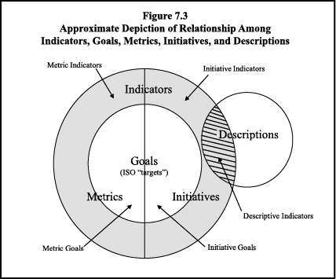
©2018 William Blackburn Consulting, Ltd..

Slide 248
Why Goals and Indicators May Fail to Deliver Performance
They are not credible with intended data users (no ownership, not realistic, not valued, not clear, data is collected by others, etc.)
Management not interested in results; results not used to make business decisions
Too many measures
Not enough time to achieve results
No accountability or recognition for results
Results not reported clearly with explanation
Results drive the wrong performance; results shaped by other influencing factors
©2017 William Blackburn Consulting, Ltd..

Slide 249
GRI G4 Aspects
Economic | Environmental
Economic Performance Market Presence Indirect Economic Impacts Procurement Practices | Materials Energy Water Biodiversity Emissions Effluents and Waste Products and Services Compliance Transport Overall Supplier Environmental Assessment Environmental Grievance Mechanisms

Slide 250
GRI G4 Aspects
SOCIAL
Labor Practices & Decent Work | Human Rights | Society | Product Responsibility
Employment Labor/Management Relations Occupational Health and Safety Training and Education Diversity and Equal Opportunity Equal Remuneration for Women and Men Supplier Assessment for Labor Practices Labor Practices Grievance Mechanisms | Investment Non-discrimination Freedom of Association and Collective Bargaining Child Labor Forced or Compulsory Labor Security Practices Indigenous Rights Assessment Supplier Human Rights Assessment Human Rights Grievance Mechanisms | Local Communities Anti-corruption Public Policy Anti-competitive Behavior Compliance Supplier Assessment for Impacts on Society Grievance Mechanisms for Impacts on Society | Customer Health and Safety Product and Service Labeling Marketing Communications Customer Privacy Compliance

Slide 251
No. of Companies
with Goals on
Subject Per
Conf Bd. Study
(total=11)
Source: W. Blackburn, Frameworks for
Integrating Citizenship and Sustainability…,
Report 1446, (2009), available at
www.Conference-Board.org

Slide 252
Public Sustainability Reporting
©2017 William Blackburn Consulting, Ltd..

Slide 253
Why Companies Transparently Report
About Their Sustainability Performance
Drives constructive change in the management of sustainability issues
Educates employees
Aligns the organization on areas of needed improvement
Hastens the resolution of problems before they magnify
Enhances company reputation for honesty
Builds stakeholder trust; strengthens relationships (and brand) with stakeholders
©2017 William Blackburn Consulting, Ltd..

Slide 254
Why Companies Don’t Transparently Report
Embarrassed about performance
Afraid the media will criticize the company for its failings
Afraid it will stir up certain stakeholders, create PR or legal problems
Concerned about reporting information that could create a competitive or security risk
Key competitors aren’t reporting on the issue; no competitive advantage
©2017 William Blackburn Consulting, Ltd..

Slide 255
Why Companies Don’t Transparently Report
Don’t fully understand the issue, not aware of the issue
Think the issue isn’t significant/material enough to be a priority; not concerned about improving performance on the issue
Think their trade association is adequately addressing the issue
Think the cost and effort of reporting would be excessive
©2017 William Blackburn Consulting, Ltd..

Slide 256
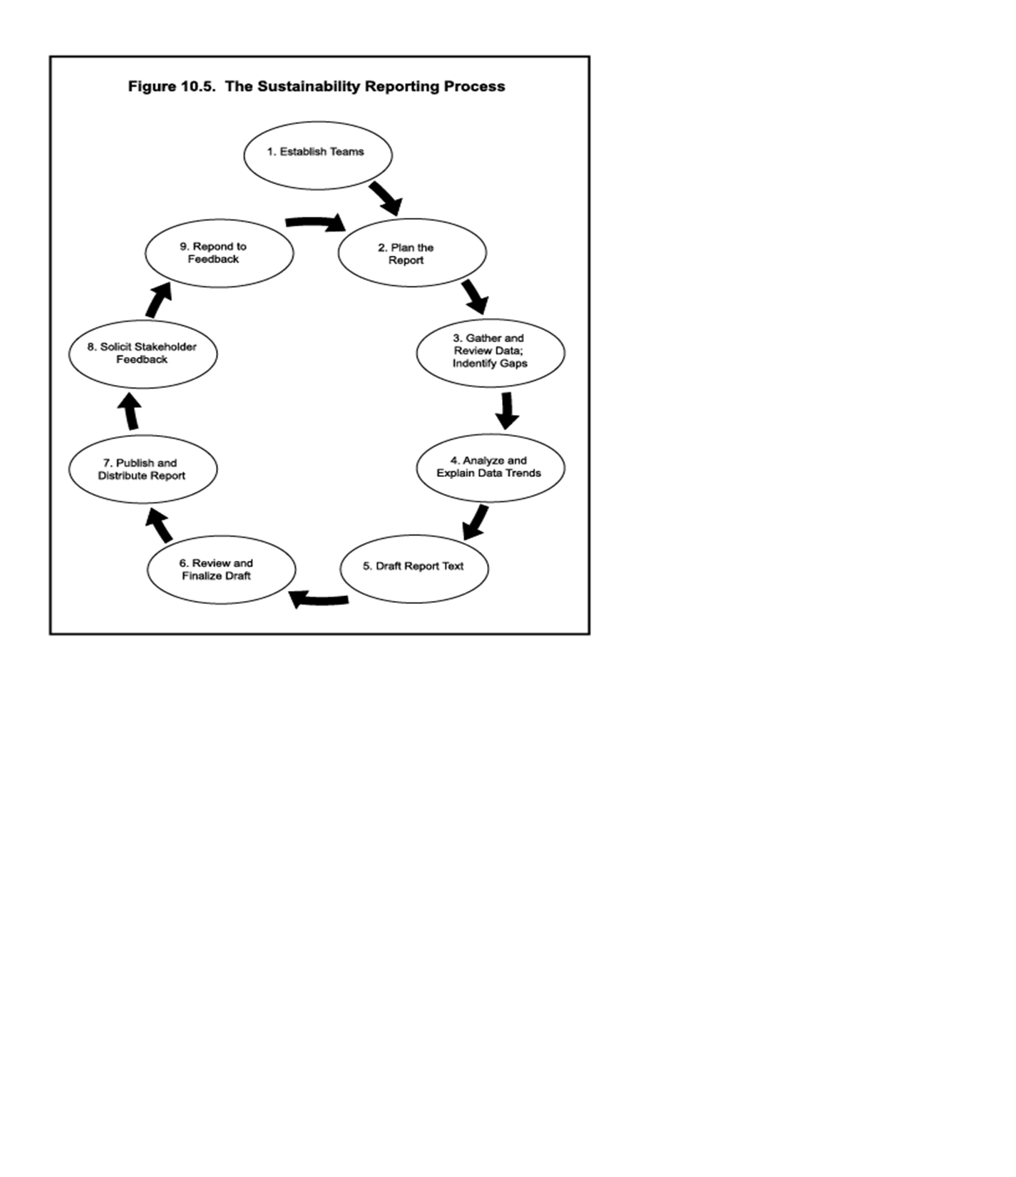
©2017 William Blackburn Consulting, Ltd..

Slide 257
Report Planning Considerations
Audiences Scope Medium: Web and/or hard copy? Size Quantity of reports; distribution plan Budget | 7. Schedule 8. Title and theme 9. Structure, organization 10. Content Reporting tone and philosophy 12. Verification
©2017 William Blackburn Consulting, Ltd.

Slide 258

Top Strategies for Strengthening the Credibility of Reports
External verification
Being honest about mistakes and bad practices
External reporting standard (GRI)
Source: Pleon Kohtes Klewes Global Stakeholder Survey--2005
©2017 William Blackburn Consulting, Ltd.

Slide 259

Majority Use
Global Reporting Initiative (GRI)
Sustainability Reporting Guidelines/ Standards
Founded 1997 by CERES & UNEP
Global multi-stakeholder consensus
Model indicators/ metrics
Reporting process
©2016 William Blackburn Consulting, Ltd.

Slide 260

GRI Background
Global Reporting Initiative Sustainability Reporting Guidelines = the international gold standard for public sustainability/CSR reporting—env., social, econ.
~4,300 GRI reports (2015) (~3/4 of total); vs. ~2200 (2010)
95% of top 250 global companies report on sustainability/CSR; 80% use GRI
Currently 4th edition (G4) (2013); new GRI “Standards” (SRS) (2016), (effective 2018)
©2017 William Blackburn Consulting, Ltd..
©2016 William Blackburn Consulting, Ltd.

Slide 261
GRI Reporting Framework
Principles (content & quality)
Standard
Disclosures (w/ protocols)
+
Sector Supplements
(suggested)
©2017 William Blackburn Consulting, Ltd.
Notes:
Key message:
Good reports: are based on a credible, trusted, transparent framework, which facilitates comparable reporting.
The G3: The improved Guidelines are part of the world’s most used and trusted framework.
2) Supporting facts: (overview of the following few slides, which provide greater detail)
The Guidelines are the basis of all the Reporting Framework. They are the entry point for all reporting organizations. They contain principles and guidance (helping determine the content of the report) as well as standard disclosures, including performance indicators
Indicator protocols: provide ‘the recipe’ for the indicators: eg, compilation methodology, further reference. Ensure consistency and comparability when different organizations report on the same indicator.
Sector supplements: respond to the limits of a ‘one size fits all’ and contains some guidance for sector specific information.
National annexes: soon to start, not yet existing. enables thorough reporting that fits in with national-specific reporting requirements, legislation, or issues – whilst being GRI based enables globally comparable information disclosures.

Slide 262

GRI- ISO 26000 Linkage*
(Content and Quality)
ISO 26000 SR Information Characteristics | GRI Reporting Principles (with Tests)
Complete | Completeness, Materiality
Accurate | Accuracy, Reliability
Balanced | Balance
Timely | Timeliness
Understandable | Clarity
Responsiveness | Stakeholder Inclusiveness
Accessible
 | Comparability
 | Sustainability Context
*Based on the GRI reporting guidelines and ISO 26000 SR standard
©2017 William Blackburn Consulting, Ltd.

Slide 263

Growing Global Multi-stakeholder Consensus on SR/Sustainability Scope
ISO 26000 SR Core Subjects | GRI Sustainability Indicator Categories/Aspects
Organizational Governance | Governance
Human Rights | Human Rights
Labour Practices | Labor Practices & Decent Work
The Environment | Environment
Fair Operating Practices | Society: Corruption, Public Policy, Anti-competitive Behavior, etc.
Consumer Issues | Product Responsibility
Community Involvement & Development | Society: Community Economic: Indirect Economic Impacts
 | Economic: Economic Performance, Market Performance, etc.
*Based on the GRI reporting guidelines and ISO 26000 SR standard
©2017 William Blackburn Consulting, Ltd.

Slide 264
Examples of the 3 Classification Levels of Indicators (GRI G4)
 | Example 1 | Example 2
Category (6) -Economic -Environment -Social (4) | Environment | Social: Labor Practices & Decent Work
Aspect (44) | Water | Occupational Health & Safety
Indicator (95) -66 core -29 additional | Total water withdrawal by source | Injury, occ. disease, lost-day, and absenteeism rates, and no. of fatalities, broken down by total workforce, gender, region & contractors

Slide 265

GRI Report Content
  CEO statement (addresses GRI conformance plus “report or explain”)
Strategy & analysis
Organizational profile (including supply chain)
Governance, commitments, & stakeholder engagement
Disclosure on Management Approach (DMA)
Performance/impact indicators
  Material core and additional indicators
  Sector supplements (certain sectors)
GRI Index
©2017 William Blackburn Consulting, Ltd..

Slide 266
Disclosures on Management Approach (DMAs)
Why topics are Material and how they are managed
Historically poor DMA reporting
Connection with Management Discussion & Analysis (MDA) for financial reports?
©2017 William Blackburn Consulting, Ltd.

Slide 267

Integrated Reporting
      Sustainability/CSR + financial reporting --helps integrate sustainability
      International Integrated Reporting Committee (IIRC) (2010)
      Sustainability Accounting Standards Board (SASB) (2011)
©2017 William Blackburn Consulting, Ltd.

Slide 268
Segregated vs. Integrated Reporting under IIRC
Segregated
Integrated
Thinking | Segregated, isolated |  | Integrated
Stewardship | Financial capital |  | All forms of capital
Focus | Past, financial |  | Past & future, connected, strategic
Timeframe | Short term |  | Short, medium & long term
Trust | Narrow disclosure |  | Greater transparency
Adaptive | Rule bound |  | Responsive to individual circumstances
Concise | Long & complex |  | Concise & material
Technology -enabled | Paper issued |  | Technology enabled

Slide 269
Today’s Agenda
The Pursuit of Sustainability by Business: What
Drivers Motivating Companies to Pursue Sustainability: Why; Company Ratings
The Pursuit of Sustainability by Business: How
Design of Sustainable /Green Products and Services
Prioritizing, Planning, Communicating
.
©2017 William Blackburn Consulting, Ltd.

Slide 270
Conclusion
Final Questions, Comments?
Surveys
Certificates & Books

Slide 271
Contact Information
Bill Blackburn
WRB@WBlackburnConsulting.com
835.530.4014
www.WBlackburnConsulting.com
George P. Nassos
  georgepnassos@gmail.com
  847-927-3526
  www.georgepnassos.com

